Slide 1
Oracle Database Concept
Ken Chen
2012/06/12

Slide 2
Preface

Slide 3
Schema Objects
In RDBMS, the physical data storage is independent from the logical data structure
In Oracle Database, a database schema is a collection of logical data structures, or schema objects
A database schema is owned y a database user and has the same name as the user name
Schema objects are user-created structures that directly refer to the data in the database (say, tables, indexes etc)

Slide 4
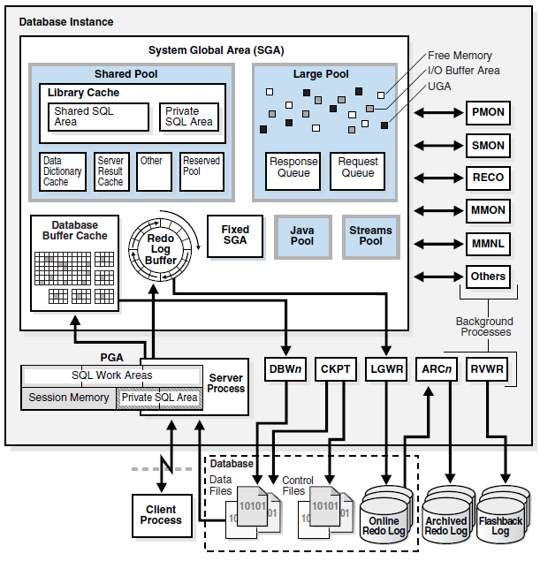
Database Architecture
This picture shows a database and its instance. For each user connection to the instance, the application is run by a client process. Each client process is associated with its own server process. The server process has its own private session memory, known as the program global area (PGA).

Slide 5
Database Architecture
Database server:
a server reliably manages a large amount of data in a multiuser environment so that users can concurrently access the same data. Data
prevents unauthorized access and provides efficient solutions for failure recovery
consists of a database and at least one database instance
A Database (Physical concept)
Is a set of files, located on disk, that store data. These files can exist independently of a database instance
A database instance (Logical concept)
Is a set of memory structures that manage database files. The instance consists of a shared memory area, called the system global area (SGA), and a set of background processes. An instance can exist independently of database files

Slide 6
Database Storage Structures
Physical Storage Structure: the physical database structures are the files that store the data
Data files (one or more per database) Contain all the database data. Contain the data of logical database structures, such as tables and indexes.
Control files (one per database) Contains metadata specifying the physical structure of the database, including the database name and the names and locations of the database files.
Online redo log files (one redo log per database) Is a set of two or more online redo log files. An online redo log is made up of redo entries (also called redo records), which record all changes made to data.
Parameter files, Diagnostic files, Backup files and archived redo log files …

Slide 7
Database Storage Structures (Cont.)
Logical Storage Structure
Data blocks At the finest level of granularity, Oracle Database data is stored in data blocks. One data block corresponds to a specific number of bytes on disk.
Extents Is a specific number of logically contiguous data blocks, obtained in a single allocation, used to store a specific type of information.
Segments Is a set of extents allocated for a user object (for example, a table or index), undo data, or temporary data.
Tablespaces A database is divided into logical storage units called tablespaces. A tablespace is the logical container for a segment. Each tablespace contains at least one data file.

Slide 8
Database Instance Structures
Oracle Database Processes
Client processes (Client side) These processes are created and maintained to run the software code of an application program or an Oracle tool. Most environments have separate computers for client processes.
Server processes (Server side) These processes communicate with client processes and interact with Oracle Database to fulfill requests. These processes communicate
Background processes (Server side) These processes consolidate functions that would otherwise be handled by multiple Oracle Database programs running for each client process. Background processes asynchronously perform I/O and monitor other Oracle Database processes to provide increased parallelism for better performance and reliability.

Slide 9
Database Instance Structures(Cont.)
Instance Memory Structures
System Global Area (SGA) The SGA is a group of shared memory structures that contain data and control information for one database instance. Examples of SGA components include cached data blocks and shared SQL areas.
Program Global Areas (PGA) A PGA is a memory region that contain data and control information for a server or background process. Access to the PGA is exclusive to the process. Each server process and background process has its own PGA.

Slide 10
I. Oracle Relational Data Structures

Slide 11
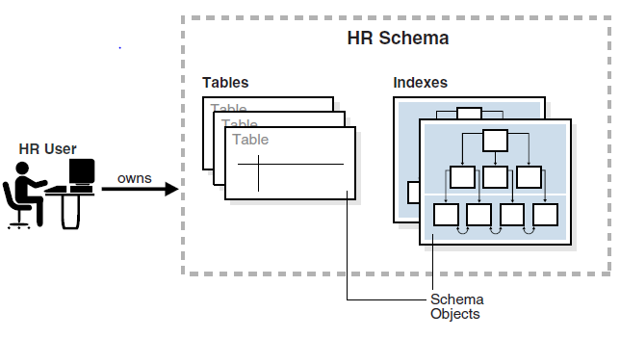
Schema Objects
A database schema is a logical container for data structures, called schema objects
For eg, A database user has a password and various database privileges. Each user owns a single schema, which has the same name as the user. The schema contains the data for the user owning the schema. For example, the hr user owns the hr schema, which contains schema objects such as the employees table, see the following picture

Slide 12
Schema Objects (Cont.)
Schema Object Types
Indexes
Partitions (are pieces of large tables and indexes)
Views
Sequences
Dimensions
Synonyms
PL/SQL subprograms and packages
Note: Other types of objects are also stored in the database and can be created and manipulated with SQL statements but are not contained in a schema. These objects include database users, roles, contexts, and directory objects.

Slide 13
Schema Object Storage
Some schema objects store data in logical storage structures called segments, Other schema objects, such as views and sequences, consist of metadata only
Oracle Database stores a schema object logically within a tablespace. There is no relationship between schemas and tablespaces: a tablespace can contain objects from different schemas, and the objects for a schema can be contained in different tablespaces. The data of each object is physically contained in one or more data files. The picture in next slide shows the relationship between schema object, tablespace and data files

Slide 14
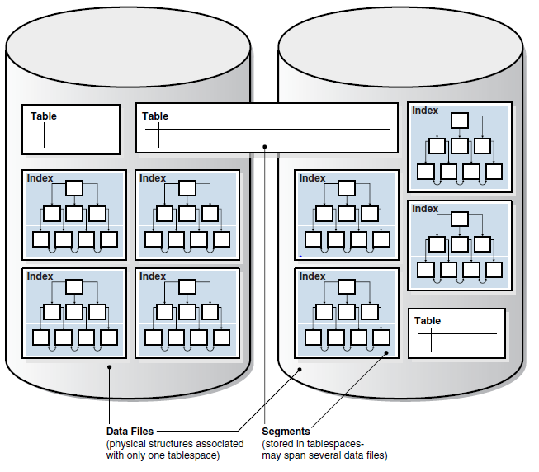
Schema Object Storage (Cont.)
Schema Object, tablespace, data files

Slide 15
SYS and SYSTEM Schemas
The administrative account SYS is automatically created when a database is created. This account can perform all database administrative functions. The SYS schema stores the base tables and views for the data dictionary. These base tables and views are critical for the operation of Oracle Database. Tables in the SYS schema are manipulated only by the database and must never be modified by any user
The SYSTEM account is also automatically created when a database is created. The SYSTEM user name is used to create additional tables and views that display administrative information, and internal tables and views used by various Oracle Database options and tools. Never use the SYSTEM schema to store tables of interest to nonadministrative users

Slide 16
Tables
Basic categories
Relational tables
Object tables
Relational table’s organizational characteristics:
heap-organized table (default for relational table) which does not store rows in any particular order
index-organized table which orders rows according to the primary key values. For some applications, index-organized tables enhance performance and use disk space more efficiently
external table which is a read-only table whose metadata is stored in the database but whose data in stored outside the database
Permanent or temporary
A permanent table definition and data persist across sessions
A temporary table definition persists in the same way as a permanent table definition, but the data exists only for the duration of a transaction or session. Temporary tables are useful in applications where a result set must be held temporarily, perhaps because the result is constructed by running multiple operations

Slide 17
ROWID
Oracle Database uses a ROWID data type to store the address (rowid) of every row in the database. Rowids fall into the following categories:
Physical rowids store the addresses of rows in heap-organized tables, clustered tables, and table and index partitions
Logical rowids store the addresses of rows in index-organized tables
Foreign rowids are identifiers in foreign tables, such as DB2 tables accessed through a gateway. They are not standard Oracle Database rowids
Use of Rowids. Oracle Database uses rowids internally for the construction of indexes. Each key in a B-tree index is associated with a rowid that points to the associated row's address for fast access. End users and application developers can also use rowids for several important functions:
Rowids are the fastest means of accessing particular rows
Rowids provide the ability to see how a table is organized
Rowids are unique identifiers for rows in a given table

Slide 18
Object Table
An Oracle object type is a user-defined type with a name, attributes, and methods. An object type defines a logical structure, but does not create storage
By default, every row object in an object table has an associated logical object identifier (OID) that uniquely identifies it in an object table. The OID column of an object table is a hidden column
For eg. CREATE TYPE department_typ AS OBJECT
( d_name VARCHAR2(100),
d_address VARCHAR2(200) );
CREATE TABLE departments_obj_t OF department_typ;
INSERT INTO departments_obj_t
VALUES ('hr', '10 Main St, Sometown, CA');

Slide 19
Temporary Table
Oracle Database temporary tables hold data that exists only for the duration of a transaction or session. Data in a temporary table is private to the session, which means that each session can only see and modify its own data
CREATE GLOBAL TEMPORARY TABLE …
ON COMMIT (specifies whether the table data is transaction-specific (default) or session-specific.)
when creating a temporary table in an Oracle database, it creates a static table definition. The temporary table is a persistent object described in the data dictionary, but appears empty until your session inserts data into the table
Segment Allocation in Temporary Tables
Temporary tables and their indexes do not automatically allocate a segment when created. Instead, temporary segments are allocated when data is first inserted. Until data is loaded in a session the table appears empty. Temporary segments are deallocated at the end of the transaction for transaction-specific temporary tables and at the end of the session for session-specific temporary tables

Slide 20
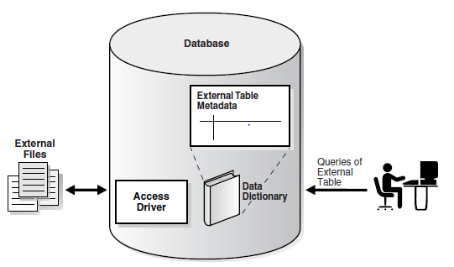
External Table
An external table accesses data in external sources as if this data were in a table in the database. You can use SQL, PL/SQL, and Java to query the external data
CREATE TABLE ... ORGANIZATION EXTERNAL …
External tables are read-only unless created with CREATE TABLE AS SELECT with the ORACLE_DATAPUMP access driver
Restrictions for external tables include no support for indexed columns, virtual columns, and column objects
Use “Table Access Driver” to talk to external tables
ORACLE_LOADER
ORACLE_DATAPUMP

Slide 21
Table Storage
Table Storage
Oracle Database uses a data segment in a tablespace to hold the table data
A data segment is composed of data files made up of data blocks
Table Organization
By default, a table is organized as a heap which is an area of storage in which data is placed where it fits best rather than in a user-specific order
Rows are not guaranteed to be retrieved in the order in which they were inserted
The column order is the same for all rows in a table. Columns are usually stored in the order in which they were listed in the CREATE TABLE statement, but this order is not guaranteed
Row Storage
The database stores rows in data blocks. Each row of a table containing data for less than 256 columns is contained in one or more row pieces. If possible, Oracle Database stores each row as one row piece
Tablespace -> data segment -> data blocks -> row pieces
data files

Slide 22
Table Clusters
Table Cluster is a group of tables that share common columns and store related data in the same blocks
cluster key: is the column or columns that the clustered tables have in common
cluster key value: is the value of the cluster key columns for a particular set of rows
All data that contains the same cluster key value is physically stored together. Each cluster key value is stored only once in the cluster and the cluster index, no matter how many rows of different tables contain the value
When use ?
Tables are primarily queried but not modified
Records from the tables are frequently queried together or joined
When not use ?
The tables are frequently accessed individually
The tables are frequently updated
The tables frequently require a full table scan
The tables require truncating

Slide 23
Index Table Clusters
Indexed cluster
Is a table cluster that uses an index to locate data
The cluster index is a B-tree index on the cluster key. A cluster index must be created before any rows can be inserted into clustered tables
To find or store a row in an indexed table or cluster, at least two I/Os must be performed:
One or more I/Os to find or store the key value in the index
Another I/O to read or write the row in the table or cluster
SQL Statement, department_id is the cluster key
CREATE CLUSTER employees_departments_cluster
(department_id NUMBER(4))
SIZE 512;
CREATE INDEX idx_emp_dept_cluster ON CLUSTER employees_departments_cluster;
CREATE TABLE employees ( ... )
CLUSTER employees_departments_cluster (department_id);
CREATE TABLE departments ( ... )
CLUSTER employees_departments_cluster (department_id);

Slide 24
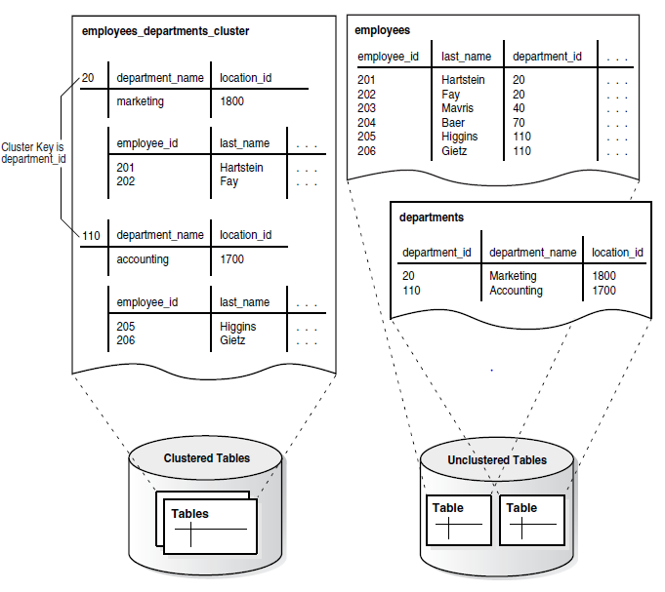
Index Table Clusters (Cont.)
Clustered table data

Slide 25
Hash Table Clusters
Hash cluster
Is like an indexed cluster, except the index key is replaced with a hash function. No separate cluster index exists. In a hash cluster, the data is the index
The key of a hash cluster, like the key of an indexed cluster, is a single column or composite key
The database hashes the cluster key into a data block address where the data is located. The database stores all rows with the same key value together on disk
To find or store a row in a hash cluster:
Oracle Database applies the hash function to the cluster key value of the row
The resulting hash value corresponds to a data block in the cluster, which the database reads or writes on behalf of the issued statement
When use ?
A table is queried much more often than modified
The hash key column is queried frequently with equality conditions
The number of rows in the table during its lifetime can reasonably be guessed
SQL Statement
CREATE CLUSTER employees_departments_cluster
(department_id NUMBER(4))
SIZE 8192 HASHKEYS 100;

Slide 26
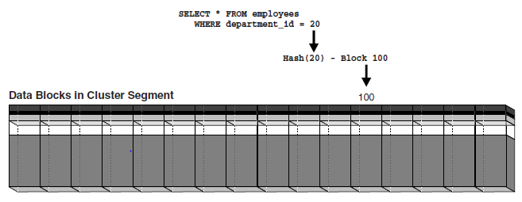
Hash Table Clusters (Cont.)
Hash Cluster Variations
single-table hash cluster
sorted hash cluster
Hash Cluster Storage
The database computes a value based on the SIZE parameter multiplied by a modified HASHKEYS value
The database preallocates at least this much space in bytes

Slide 27
Index
When use (when any of the following situations applies) ?
The indexed columns are queried frequently and return a small percentage of the total number of rows in the table
A referential integrity constraint exists on the indexed column or columns. The index is a means to avoid a full table lock that would otherwise be required if update the parent table primary key, merge into the parent table, or delete from the parent table
A unique key constraint will be placed on the table and you want to manually specify the index and all index options
Note, the presence of many indexes on a table degrades DML performance because the database must also update the indexes
Index properties:
Usability: Can make the index unusable which is not maintained by DML operations and will be ignored by the optimizer. It does not consume any space
Visibility: Can make the index invisible which is maintained by DML operations and is not used by default by the optimizer

Slide 28
Index (Cont.)
Composite index
also called a concatenated index, is an index on multiple columns in a table
Columns in a composite index should appear in the order that makes the most sense for the queries that will retrieve data and need not be adjacent in the table.
Composite indexes can speed retrieval of data for SELECT statements in which the WHERE clause references all or the leading portion of the columns in the composite index. Therefore, the order of the columns used in the definition is important. In general, the most commonly accessed columns go first
Example:
Suppose an application frequently queries the last_name, job_id, and salary columns in the employees table. Also assume that last_name has high cardinality, which means that the number of distinct values is large compared to the number of table rows. You create an index with the following column order: CREATE INDEX employees_ix ON employees (last_name, job_id, salary);
Queries that access all three columns, only the last_name column, or only the last_name and job_id columns use this index. In this example, queries that do not access the last_name column do not use the index
Note: In some cases, such as when the leading column has very low cardinality, the database may use a skip scan of this index
Multiple indexes can exist for the same table as long as the permutation of columns differs for each index, say Index (col1, col2) is different from Index(col2, col1)

Slide 29
Index (Cont.)
Unique and Nonunique Indexes
Unique indexes guarantee that no two rows of a table have duplicate values in the key column or column
Nonunique indexes permit duplicates values in the indexed column or columns. For a nonunique index, the rowid is included in the key in sorted order, so nonunique indexes are sorted by the index key and rowid (ascending)
Note: Oracle Database does not index table rows in which all key columns are null, except for bitmap indexes or when the cluster key column value is null

Slide 30
Types of Index
B-tree indexes. Have following subtypes
Index-organized tables
Reverse key indexes
Descending indexes
B-tree cluster indexes
Bitmap and bitmap join indexes
Function-based indexes
Application domain indexes

Slide 31
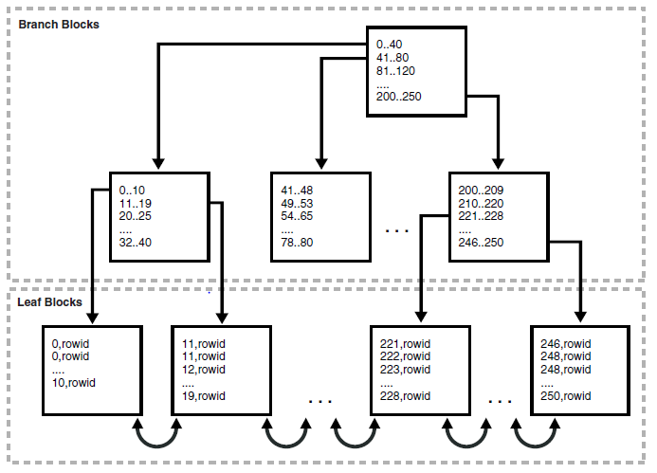
B-Tree Indexes
B-tree indexes.
short for balanced trees, are the most common type of database index. A B-tree index is an ordered list of values divided into ranges. By associating a key with a row or range of rows, B-trees provide excellent retrieval performance for a wide range of queries, including exact match and range searches

Slide 32
B-Tree Indexes (Cont.)
Branch blocks
store the minimum key prefix needed to make a branching decision between two keys. The branch blocks contain a pointer to the child block containing the key. The number of keys and pointers is limited by the block size
Leaf blocks
every indexed data value and a corresponding rowid used to locate the actual row. Each entry is sorted by (key, rowid). Within a leaf block, a key and rowid is linked to its left and right sibling entries. The leaf blocks themselves are also doubly linked. In Figure 3–1 the leftmost leaf block (0-10) is linked to the second leaf block (11-19)
A B-tree index is balanced, so retrieval of any record from anywhere in the index takes approximately the same amount of time

Slide 33
B-Tree Indexes (Cont.)
Index Scans
In an index scan, the database retrieves a row by traversing the index, using the indexed column values specified by the statement. If the database scans the index for a value, then it will find this value in n I/Os where n is the height of the B-tree index. This is the basic principle behind Oracle Database indexes
If a SQL statement accesses only indexed columns, then the database reads values directly from the index rather than from the table. If the statement accesses columns in addition to the indexed columns, then the database uses rowids to find the rows in the table. Typically, the database retrieves table data by alternately reading an index block and then a table block
Full Index Scan
In a full index scan, the database reads the entire index in order
A full index scan is available if a predicate (WHERE clause) in the SQL statement references a column in the index, and in some circumstances when no predicate is specified. A full scan can eliminate sorting because the data is ordered by index key

Slide 34
B-Tree Indexes (Cont.)
Fast Full Index Scan
Is a full index scan in which the database reads the index blocks in no particular order. The database accesses the data in the index itself, without accessing the table.
Fast full index scans are an alternative to a full table scan when the index contains all the columns that are needed for the query, and at least one column in the index key has the NOT NULL constraint
Index Range Scan
Is an ordered scan of an index that has the following characteristics
One or more leading columns of an index are specified in conditions. A condition specifies a combination of one or more expressions and logical (Boolean) operators and returns a value of TRUE, FALSE, or UNKNOWN
0, 1, or more values are possible for an index key (the index is non-unique)
The database commonly uses an index range scan to access selective data. The selectivity is the percentage of rows in the table that the query selects. A query that selects a small percentage of rows has good selectivity. Selectivity is tied to a query predicate, such as WHERE last_name LIKE 'A%', or a combination of predicates
An index range scan can be bounded on both sides, as in a query for departments with IDs between 10 and 40, or bounded on only one side, as in a query for IDs over 40. To scan the index, the database moves backward or forward through the leaf blocks. For example, a scan for IDs between 10 and 40 locates the first index leaf block that contains the lowest key value that is 10 or greater. The scan then proceeds horizontally through the linked list of leaf nodes until it locates a value greater than 40

Slide 35
B-Tree Indexes (Cont.)
Index Unique Scan
In contrast to an index range scan, an index unique scan must have either 0 or 1 rowid associated with an index key
The database performs a unique scan when a predicate references all of the columns in a UNIQUE index key using an equality operator. An index unique scan stops processing as soon as it finds the first record because no second record is possible
Index Skip Scan
Uses logical subindexes of a composite index. The database "skips" through a single index as if it were searching separate indexes
Skip scanning is beneficial if there are few distinct values in the leading column of a composite index and many distinct values in the nonleading key of the index
The database may choose an index skip scan when the leading column of the composite index is not specified in a query predicate (or may use full table scan or full index scan).
In a skip scan, the number of logical subindexes is determined by the number of distinct values in the leading column

Slide 36
B-Tree Indexes (Cont.)
Reverse Key Indexes
A reverse key index is a type of B-tree index that physically reverses the bytes of each index key while keeping the column order
Reversing the key solves the problem of contention for leaf blocks in the right side of a B-tree index. This problem can be especially acute in an Oracle Real Application Clusters (Oracle RAC) database in which multiple instances repeatedly modify the same block.
In a reverse key index, the reversal of the byte order distributes inserts across all leaf keys in the index. Thus, I/O for insertions of sequential keys is more evenly distributed.
Because the data in the index is not sorted by column key when it is stored, the reverse key arrangement eliminates the ability to run an index range scanning query in some cases
Ascending and Descending Indexes
In an ascending index, Oracle Database stores data in ascending order
By specifying the DESC keyword in the CREATE INDEX statement, we can create a descending index. In this case, the index stores data on a specified column or columns in descending order
Descending indexes are useful when a query sorts some columns ascending and others descending CREATE INDEX emp_name_dpt_ix ON hr.employees(last_name ASC, department_id DESC);

Slide 37
B-Tree Indexes (Cont.)
Key Compression
In general, index keys have two pieces, a grouping piece and a unique piece
Key compression breaks the index key into a prefix entry, which is the grouping piece, and a suffix entry, which is the unique or nearly unique piece. The database achieves compression by sharing the prefix entries among the suffix entries in an index block
The index stores a specific prefix once per leaf block at most. Only keys in the leaf blocks of a B-tree index are compressed. In the branch blocks the key suffix can be truncated, but the key is not compressed
Key compression can greatly reduce the space consumed by the index in some circumstances

Slide 38
Bitmap Indexes
Bitmap Index
The database stores a bitmap for each index key
In a bitmap index, each index key stores pointers to multiple rows
Each bit in the bitmap corresponds to a possible rowid. If the bit is set, then the row with the corresponding rowid contains the key value. A mapping function converts the bit position to an actual rowid, so the bitmap index provides the same functionality as a B-tree index although it uses a different internal representation
If the indexed column in a single row is updated, then the database locks the index key entry (for example, M or F) and not the individual bit mapped to the updated row. Because a key points to many rows, DML on indexed data typically locks all of these rows. For this reason, bitmap indexes are not appropriate for many OLTP applications
Bitmap indexes are primarily designed for data warehousing or environments in which queries reference many columns in an ad hoc fashion. Situations that may call for a bitmap index include:
The indexed columns have low cardinality, that is, the number of distinct values is small compared to the number of table rows (say, the gender, only ‘M’ or ‘F’)
The indexed table is either read-only or not subject to significant modification by DML statements

Slide 39
Bitmap Indexes (Cont.)
Bitmap Join Indexes
Is a bitmap index for the join of two or more tables. For each value in a table column, the index stores the rowid of the corresponding row in the indexed table
A bitmap join index is an efficient means of reducing the volume of data that must be joined by performing restrictions in advance
Example:
assume that users often query the number of employees with a particular job type: SELECT COUNT(*)
FROM employees, jobs
WHERE employees.job_id = jobs.job_id
AND jobs.job_title = 'Accountant';
The preceding query would typically use an index on jobs.job_title to retrieve the rows for ‘Accountant’ and then the job ID, and an index on employees.job_id to find the matching rows. To retrieve the data from the index itself rather than from a scan of the tables, you could create a bitmap join index as follows: CREATE BITMAP INDEX employees_bm_idx
ON employees (jobs.job_title)
FROM employees, jobs
WHERE employees.job_id = jobs.job_id;

Slide 40
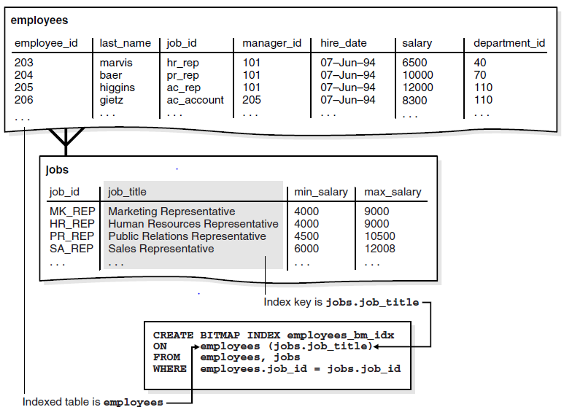
Bitmap Indexes (Cont.)

Slide 41
Bitmap Indexes (Cont.)
Bitmap Storage Structure
Oracle Database uses a B-tree index structure to store bitmaps for each indexed key. For example, if jobs.job_title is the key column of a bitmap index, then the index data is stored in one B-tree. The individual bitmaps are stored in the leaf blocks
Assume that the jobs.job_title column has unique values Shipping Clerk, Stock Clerk, and several others. A bitmap index entry for this index has the following components: (1) The job title as the index key (2) A low rowid and high rowid for a range of rowids (3) A bitmap for specific rowids in the range Conceptually, an index leaf block in this index could contain entries as follows: Shipping Clerk(1),AAAPzRAAFAAAABSABQ,AAAPzRAAFAAAABSABZ(2),0010000100 (3) Shipping Clerk,AAAPzRAAFAAAABSABa,AAAPzRAAFAAAABSABh,010010 Stock Clerk,AAAPzRAAFAAAABSAAa,AAAPzRAAFAAAABSAAc,1001001100 Stock Clerk,AAAPzRAAFAAAABSAAd,AAAPzRAAFAAAABSAAt,0101001001 Stock Clerk,AAAPzRAAFAAAABSAAu,AAAPzRAAFAAAABSABz,100001 …
Assume that a session updates the job ID of one employee from ‘Shipping Clerk’ to ‘Stock Clerk’. In this case, the session requires exclusive access to the index key entry for the old value (Shipping Clerk) and the new value (Stock Clerk). Oracle Database locks the rows pointed to by these two entries—but not the rows pointed to by Accountant or any other key—until the UPDATE commits
The data for a bitmap index is stored in one segment. Oracle Database stores each bitmap in one or more pieces. Each piece occupies part of a single data block

Slide 42
Function-Based Indexes
Function-based index
A function-based index computes the value of a function or expression involving one or more columns and stores it in the index. It can be either a B-tree or a bitmap index.
Function-based indexes are efficient for evaluating statements that contain functions in their WHERE clauses. The database only uses the function-based index when the function is included in a query.
A function-based index is useful for indexing only specific rows in a table. For example, the cust_valid column in the sh.customers table has either I or A as a value. To index only the A rows, you could write a function that returns a null value for any rows other than the A rows. You could create the index as follows: CREATE INDEX cust_valid_idx ON customers ( CASE cust_valid WHEN 'A' THEN 'A' END );
The optimizer can use an index range scan on a function-based index for queries with expressions in WHERE clause. The range scan access path is especially beneficial when the predicate (WHERE clause) has low selectivity.
A virtual column is useful for speeding access to data derived from expressions.
The optimizer performs expression matching by parsing the expression in a SQL statement and then comparing the expression trees of the statement and the function-based index. This comparison is case-insensitive and ignores blank spaces.

Slide 43
Index Storage
Index Storage
Oracle Database stores index data in an index segment. Space available for index data in a data block is the data block size minus block overhead, entry overhead, rowid, and one length byte for each value indexed
The tablespace of an index segment is either the default tablespace of the owner or a tablespace specifically named in the CREATE INDEX statement. For ease of administration you can store an index in a separate tablespace from its table. For example, you may choose not to back up tablespaces containing only indexes, which can be rebuilt, and so decrease the time and storage required for backups

Slide 44
Index-Organized Tables
Index-Organized table
In an index-organized table, rows are stored in an index defined on the primary key for the table. Each index entry in the B-tree also stores the non-key column values. Thus, the index is the data, and the data is the index
The tablespace of an index segment is either the default tablespace of the owner or a tablespace specifically named in the CREATE INDEX statement. For ease of administration you can store an index in a separate tablespace from its table. For example, you may choose not to back up tablespaces containing only indexes, which can be rebuilt, and so decrease the time and storage required for backups
Index-organized tables provide faster access to table rows by primary key or a valid prefix of the key. The presence of non-key columns of a row in the leaf block avoids an additional data block I/O. Another benefit is the avoidance of the space overhead of a separate primary key index
Index-organized tables are useful when related pieces of data must be stored together or data must be physically stored in a specific order. This type of table is often used for information retrieval, spatial, and OLAP applications

Slide 45
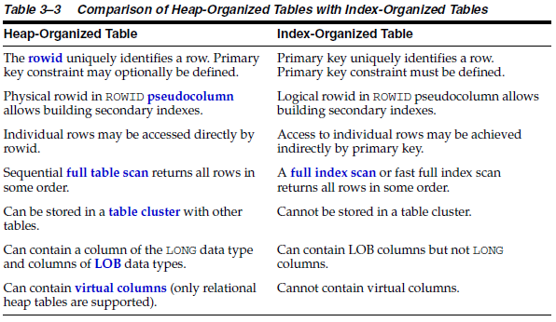
Index-Organized Tables (Cont.)

Slide 46
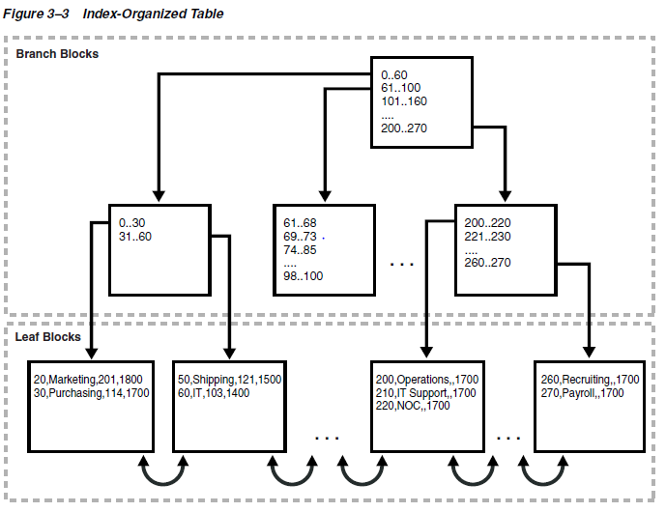
Index-Organized Tables (Cont.)
An index-organized table stores all data in the same structure
and does not need to store the rowid

Slide 47
Index-Organized Tables (Cont.)
Row Overflow Area
When creating an index-organized table, you can specify a separate segment as a row overflow area. In index-organized tables, B-tree index entries can be large because they contain an entire row, so a separate segment to contain the entries is useful
If a row overflow area is specified, then the database can divide a row in an index-organized table into the following parts:
The index entry: This part contains column values for all the primary key columns, a physical rowid that points to the overflow part of the row, and optionally a few of the non-key columns. This part is stored in the index segment
The overflow part: This part contains column values for the remaining non-key columns. This part is stored in the overflow storage area segment

Slide 48
Index-Organized Tables (Cont.)
Secondary Indexes on Index-Organized Tables
Secondary index is something like index on index
Oracle Database uses row identifiers called logical rowids for index-organized tables. A logical rowid is a base64-encoded representation of the table primary key. The logical rowid length depends on the primary key length
For heap-based table, rows in index leaf blocks can move within or between blocks because of insertions. But rows in index-organized tables do not migrate as heap-organized rows do. Because rows in index-organized tables do not have permanent physical addresses, the database uses logical rowids based on primary key
Secondary indexes provide fast and efficient access to index-organized tables using columns that are neither the primary key nor a prefix of the primary key

Slide 49
Index-Organized Tables (Cont.)
Logical Rowids and Physical Guesses
Secondary indexes use the logical rowids to locate table rows. A logical rowid includes a physical guess, which is the physical rowid of the index entry when it was first made
Oracle Database can use physical guesses to probe directly into the leaf block of the index-organized table, bypassing the primary key search. When the physical location of a row changes, the logical rowid remains valid even if it contains a physical guess that is stale
For a heap-organized table, access by a secondary index involves a scan of the secondary index and an additional I/O to fetch the data block containing the row. For index-organized tables, access by a secondary index varies, depending on the use and accuracy of physical guesses: (1) Without physical guesses, access involves two index scans: a scan of the secondary index followed by a scan of the primary key index. (2) With physical guesses, access depends on their accuracy:
With accurate physical guesses, access involves a secondary index scan and an additional I/O to fetch the data block containing the row.
With inaccurate physical guesses, access involves a secondary index scan and an I/O to fetch the wrong data block (as indicated by the guess), followed by an index unique scan of the index organized table by primary key value.

Slide 50
Partition
Partition
Partitioning enables us to decompose very large tables and indexes into smaller and more manageable pieces called partitions. Each partition is an independent object with its own name and optionally its own storage characteristics
With partition, we work on smaller data set and can benefit from this, lock contention, resource contention, (increase manageability, availability, performance, and scalability)...
Characteristics
All partition share logical attributes, say column names, data types, and constraints
Each partition can have its own physical attributes such as the tablespace to which it belongs
Partition Key
Is a set of one or more columns that determines the partition in which each row in a partitioned table should go
Oracle Database automatically directs insert, update, and delete operations to the appropriate partition by using the partition key

Slide 51
Partition (Cont.)
Partitioning Strategies
Range partitioning The database maps rows to partitions based on ranges of values of the partitioning key.
List Partitioning The database uses a list of discrete values as the partition key for each partition.
Hash Partitioning The database maps rows to partitions based on a hashing algorithm that the database applies to the user-specified partitioning key.
Partitioned Table
It consists of one or more partitions, which are managed individually and can operate independently of the other partition
It is made up of one or more table partition segments. Each table partition segments contains a portion of the table data. Note: No table segment created for partition table.
Some or all partitions of a heap-organized table can be stored in compressed format. Table compression can be declared for a tablespace, table, or table partition
We can alter the compression attribute for a table, in which case the change only applies to new data going into that table. So, a single table or partition may contain compressed and un-compressed data
Note: If compression could increase the size of a block, then the database does not apply it to the block

Slide 52
Partition (Cont.)
Partitioned Index
Is an index that, like a partitioned table, has been decomposed into smaller and more manageable pieces
Local Partitioned Indexes
Each index partition is applied to each partition of the partitioned table
For e.g, create a partitioned table which has two partitions as following, and then create local partitioned index on the partitioned table CREATE TABLE hash_sales
( prod_id NUMBER(6)
, cust_id NUMBER
, time_id DATE
...
)
PARTITION BY HASH (prod_id)
PARTITIONS 2;
CREATE INDEX hash_sales_idx ON hash_sales(time_id) LOCAL;

Slide 53
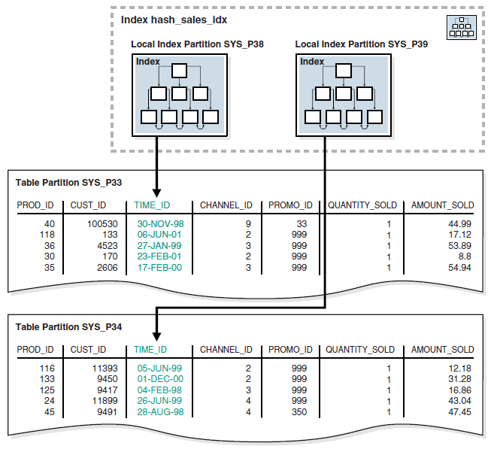
Partition (Cont.)
Local Partitioned Indexes (Cont.)

Slide 54
Partition (Cont.)
Local Partitioned Indexes Storage
Like a table partition, a local index partition is stored in its own segment. Each segment contains a portion of the total index data. Thus, a local index made up of four partitions is not stored in a single index segment, but in four separate segments
Global Partitioned Indexes
Is a B-tree index that is partitioned independently of the underlying table on which it is created
A single index partition can point to any or all table partitions, whereas in a locally partitioned index, a one-to-one parity exists between index partitions and table partitions
Can partition a global index by range or by hash

Slide 55
Partition (Cont.)
Global Partitioned Indexes (Cont.)
For e.g CREATE TABLE time_range_sales
( prod_id NUMBER(6)
, cust_id NUMBER
, time_id DATE
...
)
PARTITION BY RANGE (time_id)
(PARTITION SALES_1998 VALUES LESS THAN (TO_DATE('01-JAN-1999','DD-MON-YYYY')),
PARTITION SALES_1999 VALUES LESS THAN (TO_DATE('01-JAN-2000','DD-MON-YYYY')),
PARTITION SALES_2000 VALUES LESS THAN (TO_DATE('01-JAN-2001','DD-MON-YYYY')),
PARTITION SALES_2001 VALUES LESS THAN (MAXVALUE));
CREATE INDEX time_channel_sales_idx ON time_range_sales (channel_id)
GLOBAL PARTITION BY RANGE (channel_id)
(PARTITION p1 VALUES LESS THAN (3),
PARTITION p2 VALUES LESS THAN (4),
PARTITION p3 VALUES LESS THAN (MAXVALUE));

Slide 56
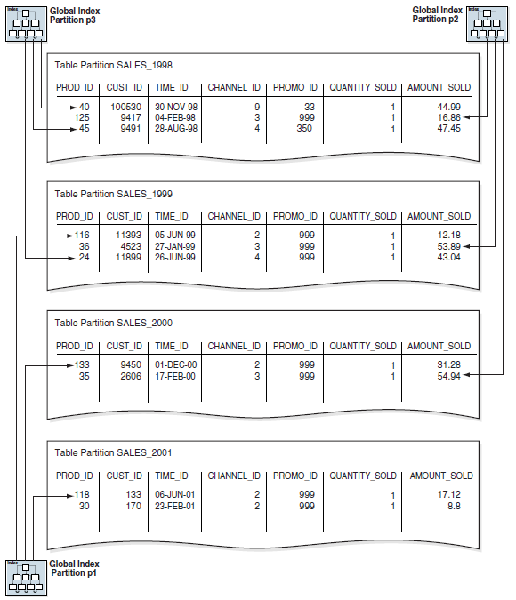
Partition (Cont.)

Slide 57
View
View
Is a logical representation of one or more tables
In essence, a view is a stored query. A view derives its data from the tables on which it is based, called base tables. Base tables can be tables or other views
a view is not allocated storage space, nor does a view contain data. It defines in data dictionary
A view has dependencies on its referenced objects, which are automatically handled by the database
Benefits
Provide an additional level of table security by restricting access to a predetermined set of rows or columns of a table
Hide data complexity (table join, calculation etc)
Present the data in a different perspective from that of the base table
Isolate applications from changes in definitions of base tables

Slide 58
View (Cont.)
How data is accessed in a View
Merges a query (whenever possible) against a view with the queries that define the view and any underlying views Oracle Database optimizes the merged query as if you issued the query without referencing the views. Therefore, Oracle Database can use indexes on any referenced base table columns, whether the columns are referenced in the view definition or in the user query against the view. Sometimes Oracle Database cannot merge the view definition with the user query. In such cases, Oracle Database may not use all indexes on referenced columns.
Parses the merged statement in a shared SQL area Oracle Database parses a statement that references a view in a new shared SQL area only if no existing shared SQL area contains a similar statement. Thus, views provide the benefit of reduced memory use associated with shared SQL.
Executes the SQL statement

Slide 59
Materialized View
Materialized View
Is query results that have been stored or "materialized" in advance as schema objects The FROM clause of the query can name tables, views, and materialized views. Collectively these objects are called master tables (a replication term) or detail tables (a data warehousing term)..
Characteristics
They contain actual data and consume storage space
They can be refreshed when the data in their master tables changes
They can improve performance of SQL execution when used for query rewrite operations
Their existence is transparent to SQL applications and users
Refresh Methods
Incremental refresh (materialized view log logs the changes to the master table)
Complete refresh
On demand refresh
Regular time intervals refresh
On transaction commits to the master table (require materialized view and the master tables are in the same database)
Query Rewrite to use the materialized view (function as a cache)

Slide 60
Dimensions
Materialized View
A typical data warehouse has two important components: dimensions and facts
A dimension is any category used in specifying business questions, for example, time, geography, product, department, and distribution channel
A fact is an event or entity associated with a particular set of dimension values, for example, units sold or profits
Hierarchical Structure of a Dimension
A dimension table is a logical structure that defines hierarchical relationships between pairs of columns or column sets
Dimensional information is stored in dimension tables
Fact information is stored in a fact table
Data analysis typically starts at higher levels in the dimensional hierarchy and gradually drills down if the situation warrants such analysis
Each value at the child level is associated with one and only one value at the parent level. A hierarchical relationship is a functional dependency from one level of a hierarchy to the next level in the hierarchy

Slide 61
Synonyms
Synonyms
Is an alias for a schema object
It requires no storage other than its definition in the data dictionary
private or public
Use public synonyms sparingly because they make database consolidation more difficult
Uses
Used to simplify SQL statements for database users
Useful for hiding the identity and location of an underlying schema object. If the underlying object must be renamed or moved, then only the synonym must be redefined. Applications based on the synonym continue to work without modification

Slide 62
Integrity Constraints
Integrity Constraint
Is a schema object that is created and dropped using SQL statements
The best practice is to enforce data integrity by using integrity constraint, instead of by other means
Can apply constraints both at the table and column level
Constraint type
NOT NULL
Unique key (unique and can be null)
Primary key (unique but can’t be null)
Foreign key (As a rule, foreign keys should be indexed.)
Check (powerful and useful, say ‘salary’ should be greater than 1000)
REF

Slide 63
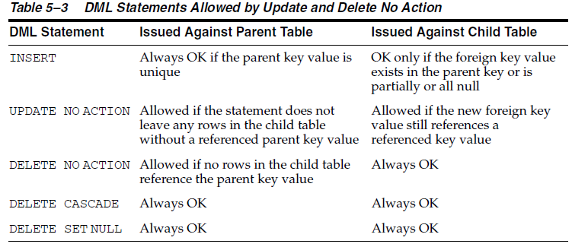
Integrity Constraints (Cont.)
When a parent key is modified:
No action on deletion or update Modify referenced key values is forbidden if the results would violate referential integrity.
Cascading deletions (DELETE CASCADE) when rows containing referenced key values are deleted, causing all rows in child tables with dependent foreign key values to also be deleted.
Deletions that set null (DELETE SET NULL) when rows containing referenced key values are deleted, causing all rows in child tables with dependent foreign key values to set those values to null.

Slide 64
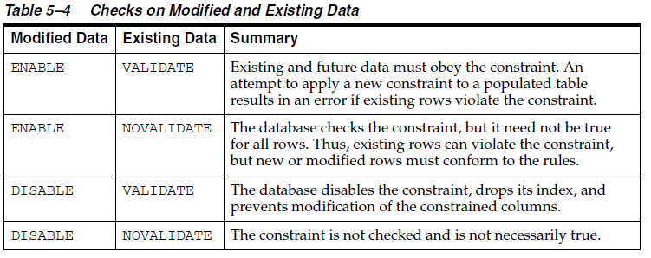
Integrity Constraints (Cont.)

Slide 65
Integrity Constraints (Cont.)
Nondeferrable Constraints
If a constraint is not deferrable, then Oracle Database never defers the validity check of the constraint to the end of the transaction. Instead, the database checks the constraint at the end of each statement. If the constraint is violated, then the statement rolls back
Deferrable Constraints
A deferrable constraint permits a transaction to use the SET CONSTRAINT clause to defer checking of this constraint until a COMMIT statement is issued
INITIALLY IMMEDIATE The database checks the constraint immediately after each statement executes. If the constraint is violated, then the database rolls back the statement.
INITIALLY DEFERRED The database checks the constraint when a COMMIT is issued. If the constraint is violated, then the database rolls back the transaction.

Slide 66
Data Dictionary
Data Dictionary
A read-only set of tables that provides administrative metadata about the database, includes:
The definitions of every schema object in the database, including default values for columns and integrity constraint information
The amount of space allocated for and currently used by the schema objects
The names of Oracle Database users, privileges and roles granted to users, and auditing information related to users
Contents
Base tables (cryptic format) These underlying tables store information about the database. Only Oracle Database should write to and read these tables.
Views These views decode the base table data into useful information, such as user or table names.
Cache
Much of the data dictionary information is in the data dictionary cache because the database constantly requires the information to validate user access and verify the state of schema objects

Slide 67
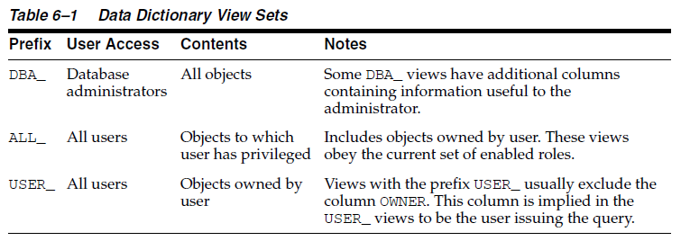
Data Dictionary (Cont.)
Data Dictionary Views
Are grouped in sets. In many cases, a set consists of three views containing similar information and distinguished from each other by their prefixes as shown below
The system-supplied DICTIONARY view contains the names and abbreviated descriptions of all data dictionary views

Slide 68
Dynamic Performance Views
Dynamic performance views
Oracle Database maintains a set of virtual tables in memory that record current database activity. Dynamic performance views (also called V$ views) are based on virtual tables
SYS owns the dynamic performance tables, whose names begin with V_$. Views are created on these tables, and then public synonyms prefixed with V$
For almost every V$ view, a corresponding GV$ view exists
catalog.sql script creates everything…
Contains
System and session parameters
Memory usage and allocation
File states (including RMAN backup files)
Progress of jobs and tasks
SQL execution
Statistics and metrics
The DBMS_METADATA package provides interfaces for extracting complete definitions of database objects

Slide 69
II. Oracle Data Access

Slide 70
SQL
SQL Standards
SQL is a standard language for relational database accepted by ANSI and ISO
The latest adopted SQL Standard is in 2003, often referred as SQL: 2003
Part of the SQL Standard - SQL/XML was revised in 2006, referred as SQL/XML: 2006
Oracle SQL includes many extensions to standard SQL
PL/SQL is Oracle property which enable us to write SQL statement like procedure language

Slide 71
DDL
Data Definition Language, define, structurally Change, Drop schema objects (Change the structure of the database)
Create, alter, and drop schema objects and other database structures, including the database itself and database users. Most DDL statements start with the keywords CREATE, ALTER, or DROP
Delete all the data in schema objects without removing the structure of these objects (TRUNCATE, unlike DELETE, it generates no undo data, which makes it faster than DELETE. Also, TRUNCATE does not invoke delete triggers)
Grant and revoke privileges and roles (GRANT, REVOKE)
Turn auditing options on and off (AUDIT, NOAUDIT)
Add a comment to the data dictionary (COMMENT)
An implicit COMMIT occurs immediately before the database executes a DDL statement and a COMMIT or ROLLBACK occurs immediately afterward

Slide 72
DML
Data Manipulation Language, query or manipulate schema objects (Change the content of the database)
Retrieve or fetch data from one or more tables or views (SELECT)
Add new rows of data into a table or view (INSERT) by specifying a list of column values or using a subquery to select and manipulate existing data
Change column values in existing rows of a table or view (UPDATE)
Update or insert rows conditionally into a table or view (MERGE)
Remove rows from tables or views (DELETE)
View the execution plan for a SQL statement (EXPLAIN PLAN)
Lock a table or view, temporarily limiting access by other users (LOCK TABLE)
A collection of DML statements that forms a logical unit of work is called a transaction. DML statements do not implicitly commit the current transaction

Slide 73
Control Statements
Transaction Control Statements - Manage the changes made by DML statements and group DML statements into transactions
Make changes to a transaction permanent (COMMIT)
Undo the changes in a transaction, since the transaction started (ROLLBACK) or since a savepoint (ROLLBACK TO SAVEPOINT)
Set a point to which you can roll back (SAVEPOINT)
Establish properties for a transaction (SET TRANSACTION)
Remove rows from tables or views (DELETE)
Specify whether a deferrable integrity constraint is checked following each DML statement or when the transaction is committed (SET CONSTRAINT)

Slide 74
Control Statements (Cont.)
Session Control Statements - Dynamically manage the properties of a user session
Alter the current session by performing a specialized function, such as enabling and disabling SQL tracing (ALTER SESSION)
Enable and disable roles, which are groups of privileges, for the current session (SET ROLE)
Session control statements do not implicitly commit the current transaction
System Control Statements - Change the properties of the database instance
The only system control statement is ALTER SYSTEM. It enables you to change settings such as the minimum number of shared servers, terminate a session, and perform other system-level tasks

Slide 75
Embedded SQL Statements
Incorporate DDL, DML, and transaction control statements within a procedural language program. They are used with the Oracle precompilers. Embedded SQL is one approach to incorporating SQL in your procedural language applications. Another approach is to use a procedural API such as Open Database Connectivity (ODBC) or Java Database Connectivity (JDBC)
Define, allocate, and release cursors (DECLARE CURSOR, OPEN, CLOSE)
Specify a database and connect to it (DECLARE DATABASE, CONNECT)
Assign variable names (DECLARE STATEMENT)
Initialize descriptors (DESCRIBE)
Specify how error and warning conditions are handled (WHENEVER)
Parse and run SQL statements (PREPARE, EXECUTE, EXECUTE IMMEDIATE)
Retrieve data from the database (FETCH)

Slide 76
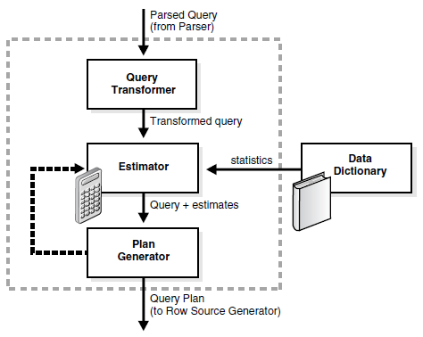
Optimizer
A.K.A query optimizer, Cost-Based optimizer, it determines the most efficient means to access data (Only for DML)
Optimizer Components
Selectivity - represents a fraction of rows from a row set. The selectivity is tied to a query predicate, or a combination of predicates
Cardinality - represents the number of rows in a row set

Slide 77
Access Paths/Optimizer Statistics
Access Paths is the way in which data is retrieved from the database
Full table scans
Rowid scans
Index scans
Cluster scans
Hash scans
Optimizer statistics are a collection of data that describe details about the database and the objects in the database
Table statistics
Column statistics
Index statistics
System statistics
Use DBMS_STATS package to gather statistics manually

Slide 78
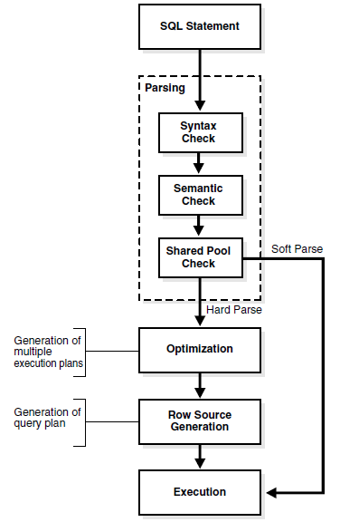
SQL processing
Stages of the SQL processing

Slide 79
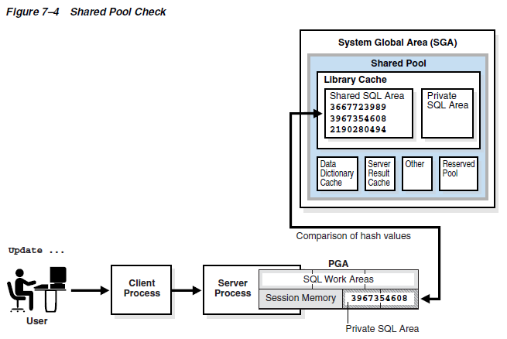
SQL processing (Cont.)
SQL Parsing
Hard parse (SQL statement hashed ID does NOT exist in Shared SQL Area, library cache miss). Need hold the latch (lock) during visiting/updating data dictionary and data dictionary cache and the Shared SQL Area
Soft parse (Library cache hit)

Slide 80
Server-Side Programming
SQL itself is not procedural
Embed SQL statement in client procedural programming languages like C/C++/JAVA.
Use server-side programming to develop data logic that resides in the database
PL/SQL (procedure, function, anonymous block which can be called on client side, say ODBC/JDBC/OCI)
Stored Java Procedure Is a Java method published to SQL and stored in the database. Like a PL/SQL subprogram, a Java procedure can be invoked directly with products like SQL*Plus or indirectly with a trigger. You can access it from any Oracle Net client—OCI, precompiler, or JDBC To publish Java methods, you write call specifications, which map Java method names, parameter types, and return types to their SQL counterparts. When called by client applications, a Java stored procedure can accept arguments, reference Java classes, and return Java result values Applications calling the Java method by referencing the name of the call specification. The run-time system looks up the call specification definition in the Oracle data dictionary and runs the corresponding Java method
Oracle Database Java Developer's Guide

Slide 81
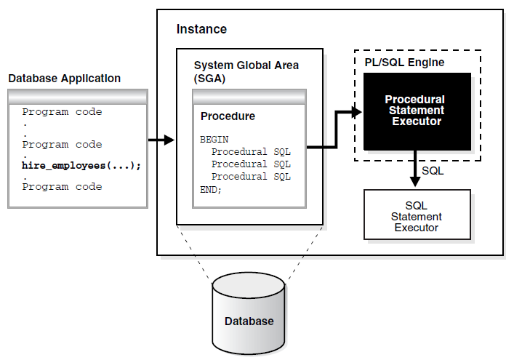
Server-Side Programming (Cont.)
PL/SQL

Slide 82
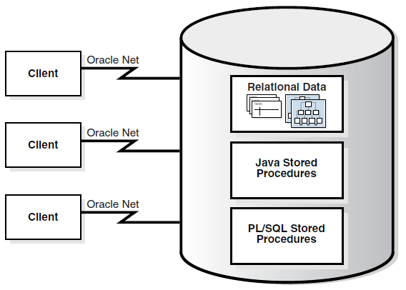
Server-Side Programming (Cont.)
Stored Java procedures

Slide 83
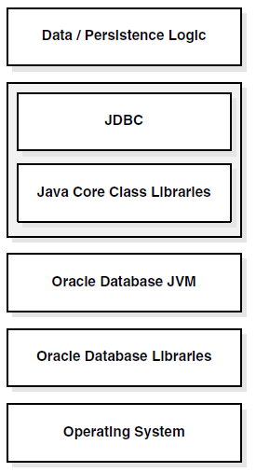
Server-Side Programming (Cont.)
Oracle JVM Components Structure

Slide 84
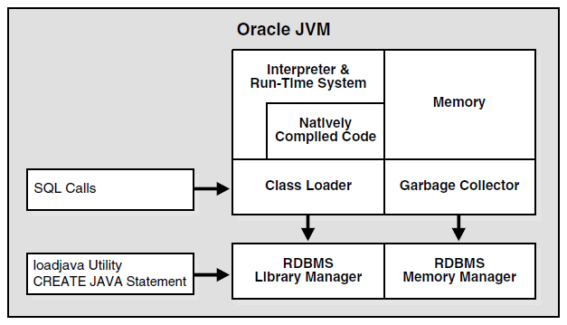
Server-Side Programming (Cont.)
Main Oracle JVM Components

Slide 85
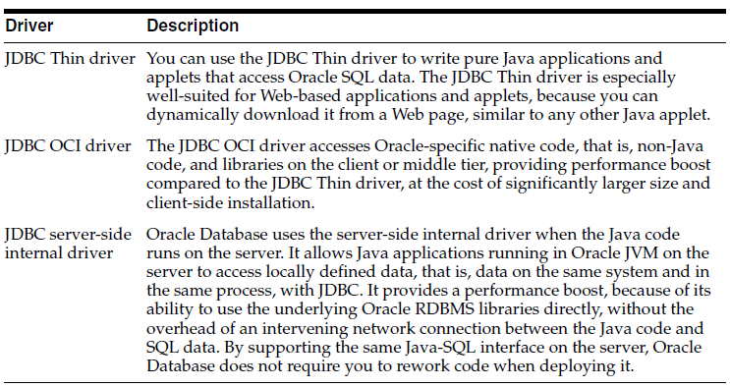
Server-Side Programming (Cont.)
Oracle JDBC Driver

Slide 86
Triggers
Is a compiled stored program unit, written in either PL/SQL or Java, that Oracle Database invokes ("fires") automatically whenever one of the following operations occurs:
DML statements (modify data in schema objects) on a particular table or view, issued by any user
DDL statements issued either by a particular user or any user
Database events (User login or logoff, errors, and database startup or shutdown etc)
Oracle strongly recommends that you only use triggers to enforce complex business rules not definable using an integrity constraint

Slide 87
Triggers (Cont.)
Types of triggers
Row triggers
Statement triggers
INSTEAD OF triggers
Event triggers
A system event trigger can be caused by events such as database instance startup and shutdown or error messages
A user event trigger is fired because of events related to user logon and logoff, DDL statements, and DML statements
Timing for Triggers (Define whether the trigger action is to be run before or after the triggering statement)
Before the firing statement
Before each row affected by the firing statement
After each row affected by the firing statement
After each row affected by the firing statement

Slide 88
III. Oracle Transaction Management

Slide 89
Transaction
Is a logical, atomic unit of work that contains one or more SQL statements
Atomicity. All tasks of a transaction are performed or none of them are. There are no partial transactions
Consistency. The transaction takes the database from one consistent state to another consistent state
Isolation. The effect of a transaction is not visible to other transactions until the transaction is committed
Durability. Changes made by committed transactions are permanent. After a transaction completes, the database ensures through its recovery mechanisms that changes from the transaction are not lost
Specifically a transaction contains ONE of the following
One or more data manipulation language (DML) statements that together constitute an atomic change to the database
One data definition language (DDL) statement
Oracle supports Statement-Level Atomicity
The failed statement does not impact the previous statement in one transaction

Slide 90
Transaction (Cont.)
Begin a transaction
A transaction begins when the first executable SQL statement is encountered
Then Oracle Database assigns the transaction to an available undo data segment to record the undo entries for the new transaction
A transaction ID is not allocated until an undo segment and transaction table slot are allocated
A transaction ID is unique to a transaction and represents the undo segment number, slot, and sequence number
End a transaction when following action occurs
A user issues a COMMIT or ROLLBACK statement without a SAVEPOINT clause One data definition language (DDL) statement
A user runs a DDL command such as CREATE, DROP, RENAME, or ALTER The database issues an implicit COMMIT statement before and after every DDL statement
A user exits normally from most Oracle Database utilities and tools, causing the current transaction to be implicitly committed. The commit behavior when a user disconnects is application-dependent and configurable
A client process terminates abnormally, causing the transaction to be implicitly rolled back using metadata stored in the transaction table and the undo segment

Slide 91
Transaction (Cont.)
We can give a transaction a name by
SET TRANSACTION ... NAME statement, which if used must be first statement of the transaction
Easier to monitor or triage the transaction by using the given name
Easier to search for specific transaction in transaction auditing redo record (LogMiner).
Can find specific transaction in V$TRANSACTION
Before the transaction commits, the state of the data is as follows:
Has generated undo data information in the SGA. The undo data contains the old data values changed by the SQL statements of the transaction
Has generated redo in the online redo log buffer of the SGA. The redo log record contains the change to the data block and the change to the undo block
Changes have been made to the database buffers of the SGA. Actually even for committed transaction, the changes stored in database buffers are not necessarily written to the data files immediately by the database writer
The rows affected by the data change are locked. Other users cannot change the data in the affected rows, nor can they see the uncommitted changes

Slide 92
Transaction (Cont.)
Rollback to savepoint
Oracle Database rolls back only the statements run after the savepoint
Oracle Database preserves the savepoint specified in the ROLLBACK TO SAVEPOINT statement, but all subsequent savepoints are lost
Oracle Database releases all table and row locks acquired after the specified savepoint but retains all data locks acquired previous to the savepoint
Rollback of Transactions:
Undoes all changes made by all the SQL statements in the transaction by using the corresponding undo segments. (The transaction table entry for every active transaction contains a pointer to all the undo data (in reverse order of application) for the transaction)
Releases all the locks of data held by the transaction
Erases all savepoints in the transaction
Ends the transaction

Slide 93
Transaction (Cont.)
Commit the transaction
A system change number (SCN) is generated for the COMMIT.
The log writer (LGWR) process writes remaining redo log entries in the redo log buffers to the online redo log and writes the transaction SCN to the online redo log. This atomic event constitutes the commit of the transaction
Oracle Database deletes savepoints
Oracle Database performs a commit cleanout. (Cache in SGA may stale) If modified blocks containing data from the committed transaction are still in the SGA, and if no other session is modifying them, then the database removes lock-related transaction information from the blocks. Ideally, the COMMIT cleans out the blocks so that a subsequent SELECT does not have to perform this task
Oracle Database marks the transaction complete
LGWR
The default behavior is for LGWR to write redo to the online redo log synchronously and for transactions to wait for the buffered redo to be on disk before returning a commit to the user. However, for lower transaction commit latency, application developers can specify that redo be written asynchronously so that transactions need not wait for the redo to be on disk and can return from the COMMIT call immediately

Slide 94
Autonomous Transactions
Is an independent transaction that can be called from another transaction
The autonomous transaction does not see uncommitted changes made by the main transaction and does not share locks or resources with the main transaction
Changes in an autonomous transaction are visible to other transactions upon commit of the autonomous transactions
Autonomous transactions can start other autonomous transactions. There are no limits, other than resource limits, on how many levels of autonomous transactions can be called
Executed within an autonomous scope (AUTONOMOUS_TRANSACTION), it commits have not impact on calling transaction (outside of the scope)
Autonomous transactions suspend the calling transaction

Slide 95
Data Concurrency and Consistency
Data concurrency
Ensures that users can access data at the same time
Serializability transaction
Data consistency
Ensures that each user sees a consistent view of the data, including visible changes made by the user's own transactions and committed transactions of other users
Oracle Database maintains data consistency by using a multiversion consistency model and various types of locks and transactions. The database can present a view of data to multiple concurrent users, with each view consistent to a point in time. Because different versions of data blocks can exist simultaneously, transactions can read the version of data committed at the point in time required by a query and return results that are consistent to a single point in time

Slide 96
Multi-Versioning Read Consistency
Is the ability to simultaneously materialize multiple versions of data
Read-consistent queries The data returned by a query is committed and consistent with respect to a single point in time
Oracle Database never permits dirty reads, which occur when a transaction reads uncommitted data in another transaction
Nonblocking queries. Readers and writers of data do not block one another
Statement-Level Read Consistency
Enforced by the database, and it guarantees that data returned by a single query is committed and consistent with respect to a single point in time
The point in time to which a single SQL statement is consistent depends on the transaction isolation level and the nature of the query In the read committed isolation level, this point is the time at which the statement was opened. For example, if a SELECT statement opens at SCN 1000, then this statement is consistent to SCN 1000 In a serializable or read-only transaction, this point is time the transaction began. For example, if a transaction begins at SCN 1000, and if multiple SELECT statements occur in this transaction, then each statement is consistent to SCN 1000 In a Flashback Query operation (SELECT ... AS OF), the SELECT statement explicitly specifies the point in time. For example, you can query a table as it appeared last Thursday at 2 p.m.

Slide 97
Multi-Versioning Read Consistency (Cont.)
Transaction-Level Read Consistency
Oracle Database can also provide read consistency to all queries in a transaction
each statement in a transaction sees data from the same point in time, which is the time at which the transaction began
Queries made by a serializable transaction see changes made by the transaction itself
Transaction-level read consistency produces repeatable reads and does not expose a query to phantom reads
Read Consistency and Undo Segments
To manage the multiversion read consistency model, the database create a read-consistent set of data when a table is simultaneously queried and updated by using undo data data (reconstructing the data from undo data segments if necessary)
Read Consistency and Transaction Tables
The database uses a transaction table to determine if a transaction was uncommitted when the database began modifying the block. Use INITRANS of CREATE TABLE/ALTER TABLE to control the amount of transaction history keeped the transaction table
The block header of every segment block contains a transaction table
Entries in the transaction table describe which transactions have rows locked and which rows in the block contain committed and uncommitted changes. The transaction table points to the undo segment, which provides information about the timing of changes made to the database

Slide 98
Isolation Levels (Cont.)
The SQL standard defines four levels of isolation in terms of the phenomena
Dirty reads A transaction reads data that has been written by another transaction that has not been committed yet.
Nonrepeatable (fuzzy) reads A transaction rereads data it has previously read and finds that another committed transaction has modified or deleted the data. For example, a user queries a row and then later queries the same row, only to discover that the data has changed.
Phantom reads A transaction reruns a query returning a set of rows that satisfies a search condition and finds that another committed transaction has inserted additional rows that satisfy the condition. For example, a transaction queries the number of employees. Five minutes later it performs the same query, but now the number has increased by one because another user inserted a record for a new hire. More data satisfies the query criteria than before, but unlike in a fuzzy read the previously read data is unchanged.

Slide 99
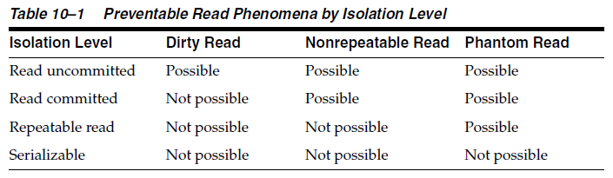
Isolation Levels (Cont.)
ISO/SQL isolation level defined in terms of phenomena that must be prevented between concurrently executing transactions

Slide 100
Isolation Levels (Cont.)
Oracle Database offers:
read committed (default) level Every query executed by a transaction sees only data committed before the query—not the transaction—began. This level of isolation is appropriate for database environments in which few transactions are likely to conflict.
serializable isolation level A transaction sees only changes committed at the time the transaction—not the query—began and changes made by the transaction itself. Suitable for: (1) With large databases and short transactions that update only a few rows. (2) Where the chance that two concurrent transactions will modify the same rows is relatively low. (3) Where relatively long-running transactions are primarily read only.
a read-only mode Similar to the serializable isolation level, but read-only transactions do not permit data to be modified in the transaction unless the user is SYS. Read-only transactions are useful for generating reports in which the contents must be consistent with respect to the time when the transaction began.s

Slide 101
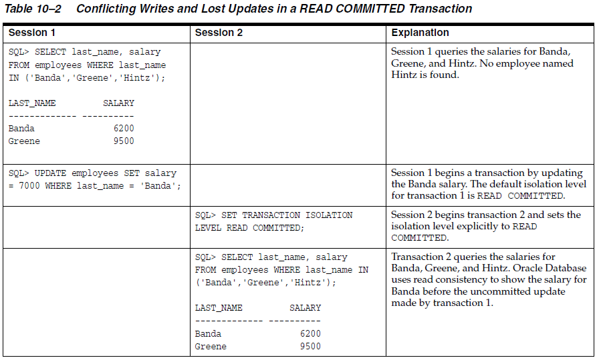
Isolation Levels (Cont.)
Read Committed Isolation example

Slide 102
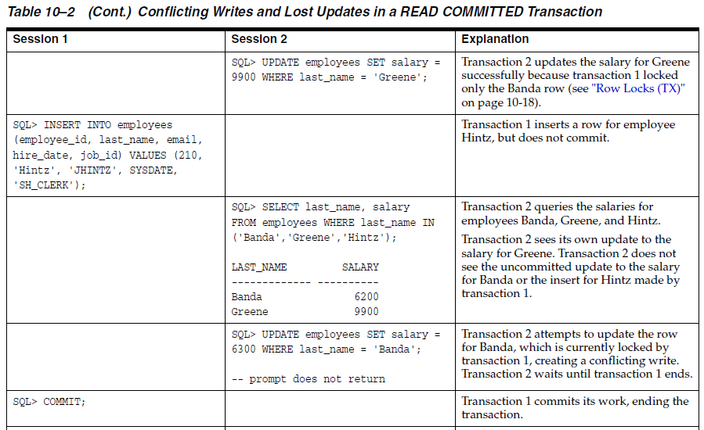
Isolation Levels (Cont.)
Read Committed Isolation example (Cont.)

Slide 103
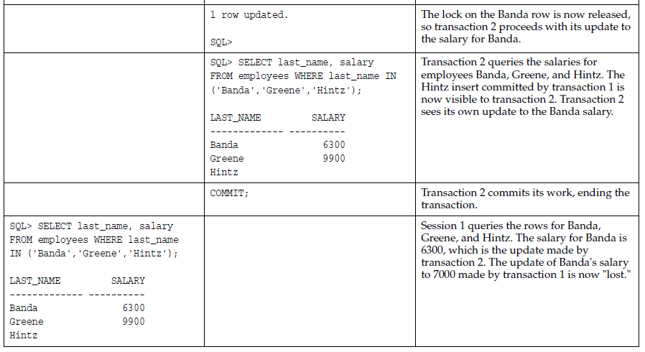
Isolation Levels (Cont.)
Read Committed Isolation example (Cont.)

Slide 104
Isolation Levels (Cont.)
Read Committed Isolation example (Cont.)

Slide 105
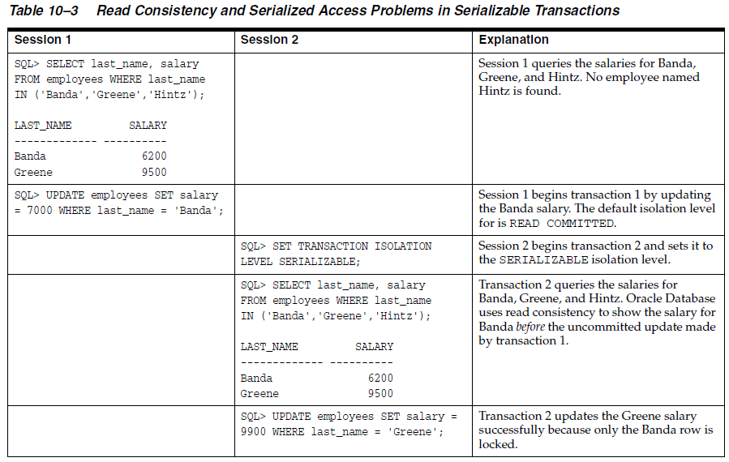
Isolation Levels (Cont.)
Serializable Isolation example

Slide 106
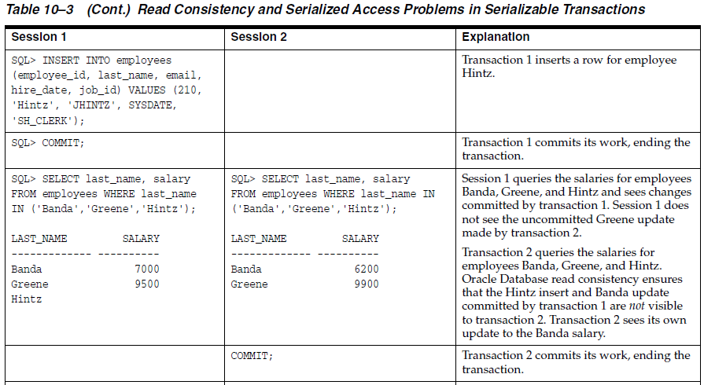
Isolation Levels (Cont.)
Serializable Isolation example (Cont.)

Slide 107
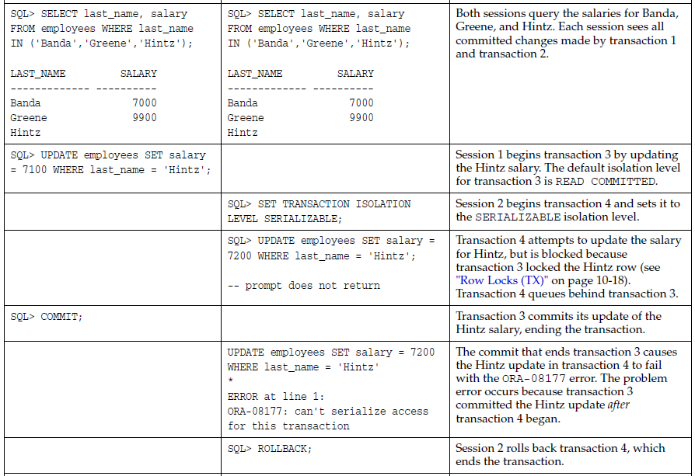
Isolation Levels (Cont.)
Serializable Isolation example (Cont.)

Slide 108
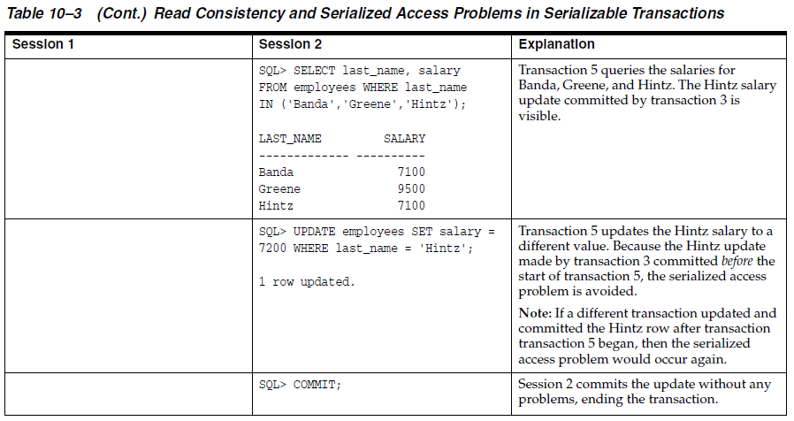
Isolation Levels (Cont.)
Serializable Isolation example (Cont.)

Slide 109
Locks
The behavior of Oracle database lock
A row is locked only when modified by a writer.
A writer of a row blocks a concurrent writer of the same row.
A reader never blocks a writer. (SELECT ... FOR UPDATE statement is a special case)
A writer never blocks a reader. Oracle database use the UNDO DATA to service the query (provide a consistent view of the row).
Lock Modes
Exclusive lock mode.
Share lock mode. Example: Assume that a transaction uses a SELECT ... FOR UPDATE statement to select a single table row. The transaction acquires an exclusive row lock and a row share table lock. The row lock allows other sessions to modify any rows other than the locked row, while the table lock prevents sessions from altering the structure of the table. Thus, the database permits as many statements as possible to execute.

Slide 110
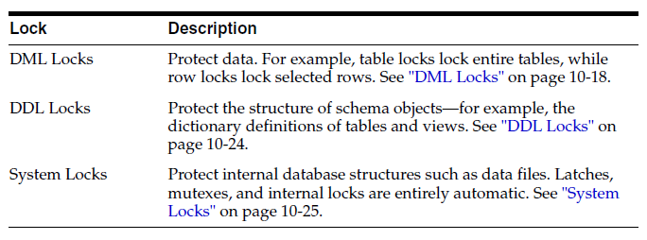
Locks (Cont.)
Lock categories

Slide 111
DML Locks
Row Level Lock
Also called a TX lock (finest lock), is a lock on a single row of table.
A transaction acquires a row lock for each row modified by an INSERT, UPDATE, DELETE, MERGE, or SELECT ... FOR UPDATE statement. The row lock exists until the transaction commits or rolls back.
If a transaction obtains a lock for a row, then the transaction also acquires a lock for the table containing the row. The table lock prevents conflicting DDL operations that would override data changes in a current transaction.
Storage of Row Locks
Unlike some databases, which use a lock manager to maintain a list of locks in memory, Oracle Database stores lock information in the data block that contains the locked row.
The database uses a queuing mechanism for acquisition of row locks. If a transaction requires a lock for an unlocked row, then the transaction places a lock in the data block. Each row modified by this transaction points to a copy of the transaction ID stored in the block header. When a transaction ends, the transaction ID remains in the block header. If a different transaction wants to modify a row, then it uses the transaction ID to determine if the lock is active. If the lock is active, then the session asks to be notified when the lock is released. Otherwise, the transaction acquires the lock.

Slide 112
DML Locks (Cont.)
Table Lock
Also called a TM lock
Is acquired by a transaction when a table is modified by an INSERT, UPDATE, DELETE, MERGE, SELECT with the FOR UPDATE clause, or LOCK TABLE statement
Table Lock modes:
Row Share (RS) This lock, also called a subshare table lock (SS), indicates that the transaction holding the lock on the table has locked rows in the table and intends to update them. A row share lock is the least restrictive mode of table lock, offering the highest degree of concurrency for a table.
Row Exclusive Table Lock (RX) This lock, also called a subexclusive table lock (SX), generally indicates that the transaction holding the lock has updated table rows or issued SELECT ... FOR UPDATE. An SX lock allows other transactions to query, insert, update, delete, or lock rows concurrently in the same table. Therefore, SX locks allow multiple transactions to obtain simultaneous SX and subshare table locks for the same table

Slide 113
DML Locks (Cont.)
Table Lock modes (Cont.):
Share Table Lock (S) A share table lock held by a transaction allows other transactions to query the table (without using SELECT ... FOR UPDATE), but updates are allowed only if a single transaction holds the share table lock. Because multiple transactions may hold a share table lock concurrently, holding this lock is not sufficient to ensure that a transaction can modify the table.
Share Row Exclusive Table Lock (SRX) This lock, also called a share-subexclusive table lock (SSX), is more restrictive than a share table lock. Only one transaction at a time can acquire an SSX lock on a given table. An SSX lock held by a transaction allows other transactions to query the table (except for SELECT ... FOR UPDATE) but not to update the table.
Exclusive Table Lock (X) This lock is the most restrictive mode of table lock, allowing the transaction that holds the lock exclusive write access to the table. Only one transaction can obtain an exclusive table lock for a table.

Slide 114
DDL Locks
DDL Lock
A data dictionary (DDL) lock protects the definition of a schema object while an ongoing DDL operation acts on or refers to the object. Lock only the schema objects, not the whole dictionary
Lock Type
Exclusive DDL Locks Prevents other sessions from obtaining a DDL or DML lock.
Share DDL Locks Prevents destructive interference with conflicting DDL operations, but allows data concurrency for similar DDL operations. A transaction holding a share DDL lock is guaranteed that the definition of the referenced schema object is constant for the duration of the transaction.
Breakable Parse Locks Parse locks are acquired so that the associated shared SQL area can be invalidated if a referenced object is altered or dropped. A parse lock is acquired in the shared pool during the parse phase of SQL statement execution.

Slide 115
System Locks
Latches
are simple, low-level serialization mechanisms that coordinate multiuser access to shared data structures, objects, and files
Spin mechanism, OS dependent. Exclusive, should be held for a very short of time
Mutexes
is a low-level mechanism that prevents an object in memory from aging out or from being corrupted when accessed by concurrent processes. A mutex is similar to a latch, but whereas a latch typically protects a group of objects, a mutex protects a single object
Consume less memory than latch
Have share mode
Internal Locks (Higher Level, more complex)
Used for :
Dictionary cache locks
File and log management locks
Tablespace and undo segment locks
DBMS_LOCK package for user lock

Slide 116
IV. Oracle Database Storage Structures

Slide 117
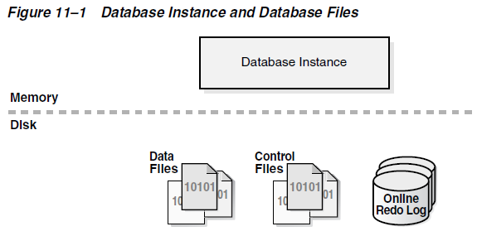
Physical Storage Structures
When ‘CREATE DATABASE’, the database creates:
Data files and temp files A data file is a physical file on disk that was created by Oracle Database and contains data structures such as tables and indexes. A temp file is a data file that belongs to a temporary tablespace. The data is written to these files in an Oracle proprietary format that cannot be read by other programs.
Control files A control file is a root file that tracks the physical components of the database.
Online redo log files The online redo log is a set of files containing records of changes made to data.

Slide 118
Mechanisms for Storing Database Files
Mechanisms for Storing Database Files:
Oracle Automatic Storage Management (Oracle ASM)
Operating system file system
Raw device
Cluster file system
Oracle ASM
Simplifies storage-related tasks such as creating and laying out databases and managing disk space
Distributes data across physical disks to eliminate hot spots and to provide uniform performance across the disks
Rebalances data automatically after storage configuration changes

Slide 119
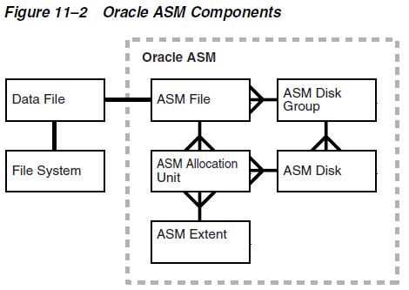
ASM Storage Components
Oracle ASM Storage Components
Oracle Database can store a data file as an Oracle ASM file in an Oracle ASM disk group, which is a collection of disks that Oracle ASM manages as a unit. Within a disk group, Oracle ASM exposes a file system interface for database files

Slide 120
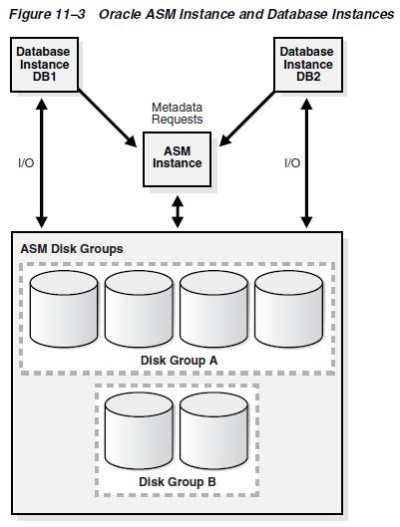
ASM Instance
Oracle ASM Instance
Is a special Oracle instance that manages Oracle ASM disks which manages the metadata of the disk group and provide file layout information to the database instances
Database instances direct I/O to ASM disks without going through an ASM instance.

Slide 121
Data files and tablespace
Data files and tablespace
Each tablespace consists of one or more data files, which conform to the operating system in which Oracle Database is running
The data for a database is collectively stored in the data files located in each tablespace of the database
A segment can span one or more data files, but it cannot span multiple tablespaces
A database must have the SYSTEM and SYSAUX tablespaces. Oracle Database automatically allocates the first data files of any database for the SYSTEM tablespace during database creation
The SYSTEM tablespace contains the data dictionary, a set of tables that contains database metadata. Typically, a database also has an undo tablespace and a temporary tablespace (usually named TEMP).

Slide 122
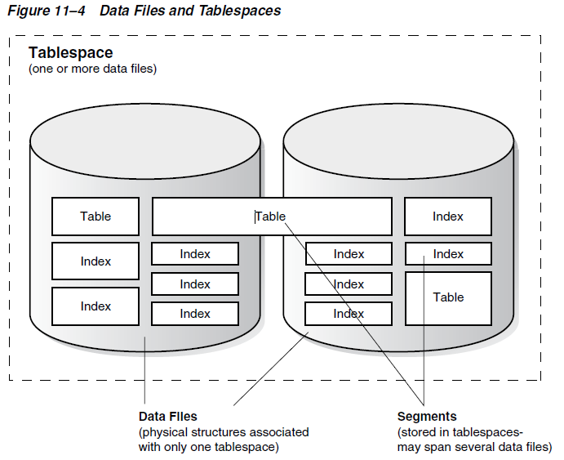
Data files and tablespace (Cont.)

Slide 123
Permanent and Temporary Data Files
Permanent and Temporary Data Files
A permanent tablespace contains persistent schema objects. Objects in permanent tablespaces are stored in data files
A temporary tablespace contains schema objects only for the duration of a session
Permanent database objects such as tables are never stored in temp files
Temp files are always set to NOLOGGING mode, which means that they never have redo generated for them. Media recovery does not recognize temp files
Cannot make a temp file read-only
Cannot create a temp file with the ALTER DATABASE statement
When you create or resize temp files, they are not always guaranteed allocation of disk space for the file size specified (may be sparse on Linux/Unix system)
Temp file information is shown in the data dictionary view DBA_TEMP_FILES and the dynamic performance view V$TEMPFILE, but not in DBA_DATA_FILES or the V$DATAFILE view

Slide 124
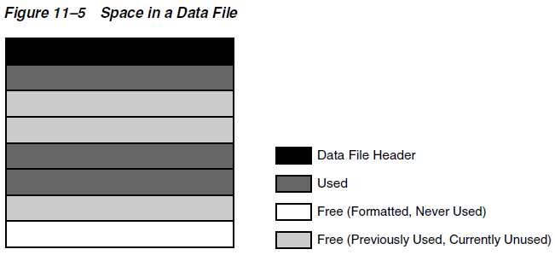
Data File Structure
Data File Structure
Data file contains a data file header which contains metadata about the data file such as its size and checkpoint SCN.
Each header contains an absolute file number and a relative file number. The absolute file number uniquely identifies the data file within the database. The relative file number uniquely identifies a data file within a tablespace

Slide 125
Control Files
Control Files
Is a small binary file associated with only one database. Each database has one unique control file (may have identical copies to avoid a single point of failure)
It contains information about data files, online redo log files, and so on that are required to open the database. It tracks structural changes to the database
It contains metadata that must be accessible when the database is not open
It contains:
The database name and database unique identifier (DBID)
The timestamp of database creation
Information about data files, online redo log files, and archived redo log files
Tablespace information
RMAN backups

Slide 126
Control Files Structure
Control Files Structure
Information about the database is stored in different sections of the control file. Each section is a set of records about an aspect of the database
Each section is stored in multiple logical control file blocks. Records can span blocks within a section
It contains the following types of records:
Circular reuse records (Noncritical, can be overwritten)
Noncircular reuse records (critical, can not be overwritten and are not changed often)

Slide 127
Online redo log
Online redo log
It records changes to the data files. Used only for recovery, also can be useful when digging historical information about database activity (LogMiner).
Oracle Database writes every transaction synchronously to the redo log buffer, which is then written to the online redo logs. The contents of the log include uncommitted transactions, undo data, and schema and object management statements.
The mechanism to write redo log
Every database instance has its own redo log thread to avoids contention for a single set of online redo log files
An online redo log consists of two or more online redo log files. Oracle Database requires a minimum of two files to guarantee that one is always available for writing while the other is being archived
Oracle Database uses only one online redo log file at a time to store records written from the redo log buffer. Log switch happens when the current log file is full and the database begin to write the other log files. Can configure log switches to occur at regular intervals.
Log writer writes to online redo log files circularly. When log writer fills the last available online redo log file, the process writes to the first log file, restarting the cycle.

Slide 128
Online redo log (Cont.)
Filled online redo log files are available for reuse depending on the archiving mode:
If archiving is disabled, which means that the database is in NOARCHIVELOG mode, then a filled online redo log file is available after the changes recorded in it have been checkpointed (written) to disk by database writer (DBWn)
If archiving is enabled, which means that the database is in ARCHIVELOG mode, then a filled online redo log file is available to log writer after the changes have been written to the data files and the file has been archived

Slide 129
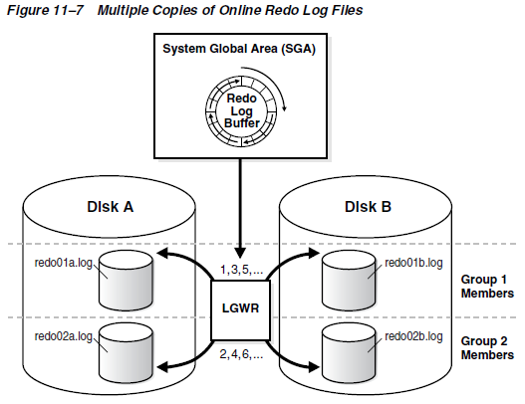
Online redo log (Cont.)
Multiple identical copies of redo log files (protect redo log loss)
An online redo log group consists of an online redo log file and its redundant copies. Each identical copy is a member of the online redo log group
LGWR writes concurrently to group 1 then group 2 then group 1 and so on. never writes concurrently to members of different groups (Group 1/2 counterpart member should have identical size)

Slide 130
Structure of the Online Redo Log
Structure of the Online Redo Log
Online redo log files contain redo records. A redo record is made up of a group of change vectors, each of which describes a change to a data block
The redo records have all relevant metadata for the change
SCN and timestamp of the change
Transaction ID of the transaction that generated the change
SCN and timestamp when the transaction committed (if it committed)
Type of operation that made the change
Name and type of the modified data segment

Slide 131
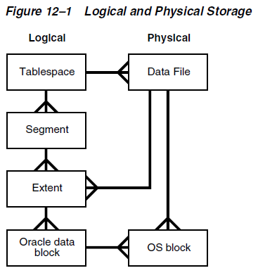
Logical Storage Structures
Oracle Database allocates logical space for all data in the database. The logical units of database space allocation are data blocks, extents, segments, and tablespaces
The following diagram shows the relationship between Physical and Logical storage. The crow's foot notation represents a one-to-many relationship

Slide 132
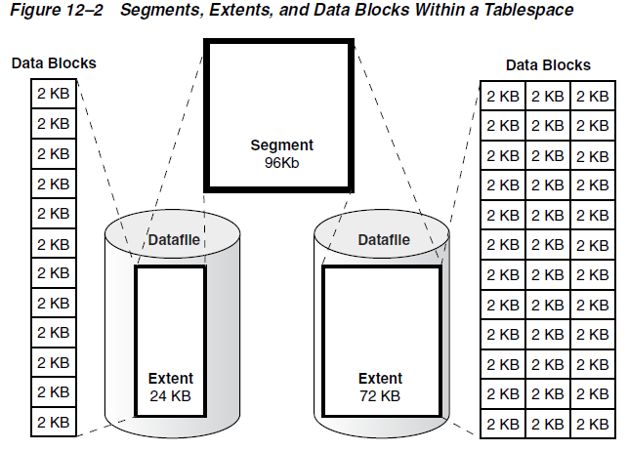
Logical Storage Structures (Cont.)
The following diagram shows the relationship among logical storage, the segment contains two extents in separate data files.

Slide 133
Logical Space Management
Logical Space Management
Locally managed tablespaces (default) (ASSM or MSSM)
Dictionary-managed tablespaces
Automatic Segment-Space Management (ASSM)
A locally managed tablespace maintains a bitmap in each data file to keep track of the free or used blocks in the data file (Has better concurrency)
Manual Segment-Space Management (MSSM)
The legacy MSSM method uses a linked list called a free list to manage free space in the segment. For database objects that have free space, a free list keeps track of blocks under the high water mark, which is the dividing line between segment space that is used and not yet used
Dictionary-Managed Tablespaces
Uses the data dictionary to manage its extents. Will have more resource contention than ASSM.

Slide 134
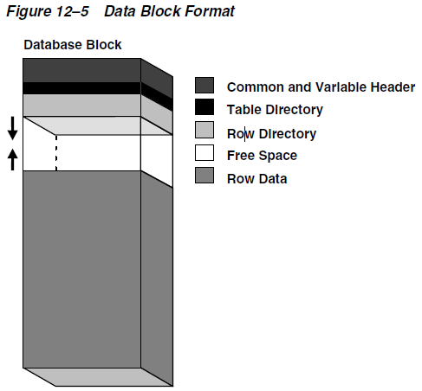
Data blocks
Data blocks
Oracle build Data blocks on top of native file system block
DB_BLOCK_SIZE
Data Block Format
Datablock overhead includes header, table dir, row dir

Slide 135
Data blocks (Cont.)
Block header
contains general information about the block, including disk address and segment type. For blocks that are transaction-managed, the block header contains active and historical transaction information (Transaction entry, the space is reserved for 23 bytes approx.)
Table directory
For a heap-organized table, this directory contains metadata about tables whose rows are stored in this block. Multiple tables can store rows in the same block
Row directory
For a heap-organized table, this directory describes the location of rows in the data portion of the block (not reclaim after row deletion)

Slide 136
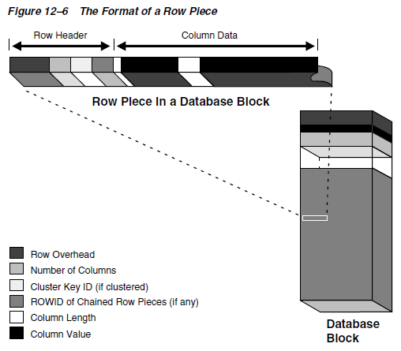
Data blocks (Cont.)
Row format
The row data part of the block contains the actual data, such as table rows or index key.
Oracle Database stores rows as variable-length records. A row is contained in one or more row pieces. Each row piece has a row header and column data.

Slide 137
Data blocks (Cont.)
Row Header
Oracle Database uses the row header to manage the row piece stored in the block and contains:
Columns in the row piece
Pieces of the row located in other data blocks If an entire row can be inserted into a single data block, then Oracle Database stores the row as one row piece. However, if all of the row data cannot be inserted into a single block or an update causes an existing row to outgrow its block, then the database stores the row in multiple row pieces. A data block usually contains only one row piece per row
Cluster keys for table cluster data
Column Data
the column data section stores the actual data, it usually stores columns in the order listed in the CREATE TABLE statement, but this order is not guaranteed. For example, columns of type LONG are created last.

Slide 138
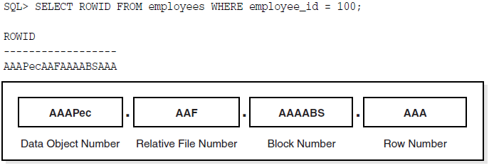
Data blocks (Cont.)
Rowid format
Oracle Database uses a rowid to uniquely identify a row. Internally, the rowid is a structure that holds information that the database needs to access a row
An extended rowid is displayed in a four-piece format, OOOOOOFFFBBBBBBRRR
OOOOOO: The data object number identifies the segment
FFF: The tablespace-relative data file number identifies the data file that contains the row
BBBBBB: The data block number identifies the block that contains the row. Block numbers are relative to their data file, not their tablespace
RRR: The row number identifies the row in the block

Slide 139
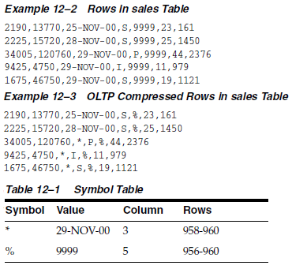
Data blocks (Cont.)
Datablock compression
symbol table at the beginning of the block stores duplicate values for the rows and columns

Slide 140
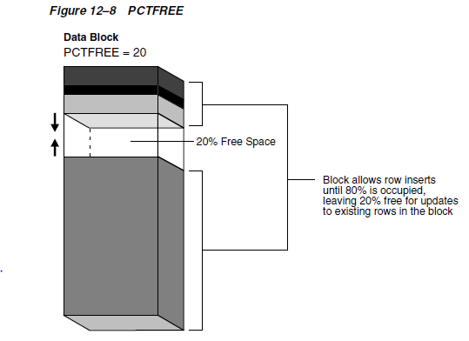
Data blocks (Cont.)
PCTFREE
This SQL storage parameter sets the minimum percentage of a data reserved as free space for updates to existing rows
The database fills a data block from the bottom up, and the meta data from top down
CREATE TABLE test_table (n NUMBER) PCTFREE 20;

Slide 141
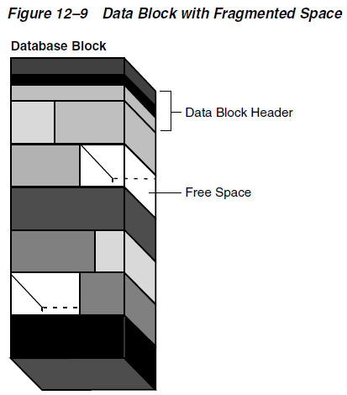
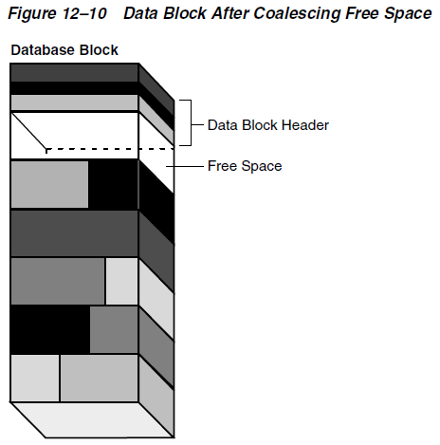
Data blocks (Cont.)
Coalescing Fragmented Space
Happened (automatically) only the left space can service the new insert/update request.

Slide 142
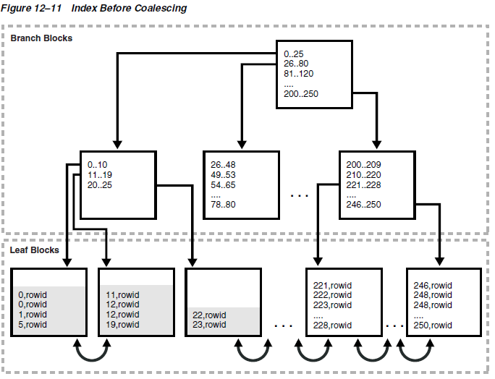
Data blocks (Cont.)
Coalescing Index Space

Slide 143
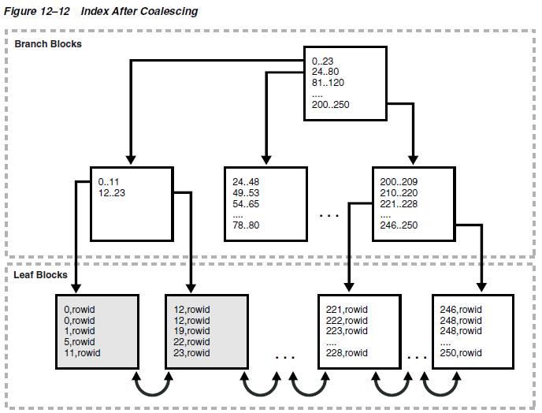
Data blocks (Cont.)
Coalescing Index Space (Cont.)

Slide 144
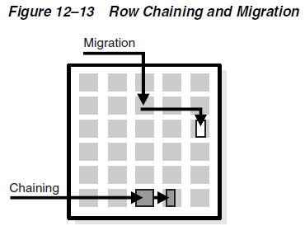
Data blocks (Cont.)
Chained and Migrated Rows (Performance impacted)
Oracle Database must manage rows that are too large to fit into a single block, there are several situations:
The row is too large to fit into one data block when it is first inserted, then row chaining happens. Multiple rows chain together to store the columns
A row that originally fit into one data block is updated so that the overall row length increases, but insufficient free space exists to hold the updated row, then row migration happens. Migrate the original row to a new block which can fit the data and The original row piece contains a pointer or "forwarding address" to the new block containing the migrated row
A row has more than 255 columns, then row chaining happens. Oracle Database can only store 255 columns in a row piece

Slide 145

Extents
Extent
Is a logical unit of database storage space allocation made up of contiguous data blocks. Data blocks in an extent are logically contiguous but can be physically spread out on disk because of RAID striping and file system implementations
Allocation of Extents
By default, the database allocates an initial extent for a data segment when the segment is created. An extent is always contained in one data file
The data blocks in the initial extent are reserved for this segment exclusively. The first data block of every segment contains a directory of the extents in the segment

Slide 146

Allocation of Extents
incremental extent
Allocated when initial extent become full
The allocation algorithm depends on whether the tablespace is locally managed or dictionary-managed. For locally managed case, first search the bitmap in the datafile which the initial extent exists, if fails, then lookup other data files which belong to the same tablespace.

Slide 147
Deallocation of Extents
Deallocation of extents
In general, the extents of a user segment do not return to the tablespace unless the object is dropped. For e.g, deleting all rows in one table does not reclaim the extents. But ‘truncate’ the table does reclaim the extents
When extents are freed, Oracle Database modifies the bitmap in the data file for locally managed tablespaces to reflect the regained extents as available space

Slide 148

Segments
Segments
A segment is a set of extents that contains all the data for a logical storage structure
User Segments
Table, table partition, or table cluster
LOB or LOB partition
Index or index partition
…
Creation of User Segments
By default, Oracle Database creates a user segment when you create a user object with CREATE statement

Slide 149

Segments (Cont.)
Creation of User Segments
Primary key is auto-indexed

Slide 150
Other Segments
Temporary Segments
Created from temporary tablespace and used as temporary workspace (memory is not sufficient) for query, sorting, hashing, merging bitmap etc
While creating an index, Oracle Database also places index segments into temporary segments and then converts them into permanent segments when the index is complete
Undo Segments
Store undo data. Undo Segments belongs to undo tablespace
When doing transaction, the database binds (assigns) the transaction to an undo segment, and therefore to a transaction table, in the current undo tablespace
When a ROLLBACK statement is issued, undo records are used to undo changes made to the database by the uncommitted transaction

Slide 151

ASSM and the High Water Mark
High Water Mark
Full table scan reads all blocks below low HWM. HWM will move right after inserting more and more rows, and the Low HWM trailing behind it. HWM never retreats.

Slide 152
Tablespaces
Tablespace
Is a logical storage container for segments which groups related schema objects together.
Tablespace Charactics
Smallfile and Bigfile Tablespaces
Read/Write and Read-Only Tablespaces
Online and Offline Tablespaces

Slide 153
System Tablespaces
SYSTEM Tablespace (owned by the SYS user), contains:
The data dictionary
Tables and views that contain administrative information about the database
Compiled stored objects such as triggers, procedures, and packages
SYSAUX Tablespace
Is an auxiliary tablespace to the SYSTEM tablespace
provides a centralized location for database metadata that does not reside in the SYSTEM tablespace
If the SYSAUX tablespace becomes unavailable, then core database functionality remains operational

Slide 154
Other Tablespaces
Undo Tablespaces (Reference Undo Segments)
Is a locally managed tablespace reserved for system-managed undo data
Temporary tablespace (Reference Temporary Segments)

Slide 155
V. Oracle Instance Architecture

Slide 156
Database instance
Database instance
A database instance is a set of memory structures that manage database files
A database is a set of physical files on disk created by the CREATE DATABASE statement
Database Instance Structure
When an instance is started, Oracle Database allocates a memory area called the system global area (SGA) and starts one or more background processes
SGA
Maintaining internal data structures that are accessed by many processes and threads concurrently
Caching data blocks read from disk
Buffering redo data before writing it to the online redo log files
Storing SQL execution plans
The SGA is shared by the Oracle processes, which include server processes and background processes

Slide 157

Database instance (Cont.)

Slide 158

Database instance (Cont.)
One-to-one or one-to-many mapping between database and database instance

Slide 159

Instance Startup
SQL*Plus STARTUP cmd or Enterprise Manager or SRVCTL utility as sysdba

Slide 160
Instance Startup (Cont.)
How an Instance Is Started
Searches for a server parameter file in a platform-specific default location and, if not found, for a text initialization parameter file (specifying STARTUP with the SPFILE or PFILE parameters overrides the default behavior)
Reads the parameter file to determine the values of initialization parameters
Allocates the SGA based on the initialization parameter settings
Starts the Oracle background processes
Opens the alert log and trace files and writes all explicit parameter settings to the alert log in valid parameter syntax
At this stage, no database is associated with the instance

Slide 161
Instance Startup (Cont.)
How an Instance Is Started
Searches for a server parameter file in a platform-specific default location and, if not found, for a text initialization parameter file (specifying STARTUP with the SPFILE or PFILE parameters overrides the default behavior)
Reads the parameter file to determine the values of initialization parameters
Allocates the SGA based on the initialization parameter settings
Starts the Oracle background processes
Opens the alert log and trace files and writes all explicit parameter settings to the alert log in valid parameter syntax
At this stage, no database is associated with the instance

Slide 162
Instance Startup (Cont.)
How a Database Is Mounted
The instance mounts a database to associate the database with this instance
To mount the database, the instance obtains the names of the database control files specified in the CONTROL_FILES initialization parameter and opens the files
Oracle Database reads the control files to find the names of the data files and the online redo log files that it will attempt to access when opening the database
How a Database Is Opened
Opening a mounted database makes it available for normal database operations. Performs the following actions:
Opens the online data files in tablespaces other than undo tablespaces
Acquires an undo tablespace
Opens the online redo log files

Slide 163


Instance Shutdown

Slide 164
Instance Shutdown
How a Database Is Closed
Normal Shutdown (a SHUTDOWN with any option other than ABORT) Oracle Database writes data in the SGA to the data files and online redo log files. Next, the database closes online data files and online redo log files
Abnormal Shutdown (a SHUTDOWN ABORT or abnormal termination occurs) Oracle Database does not write data in the buffers of the SGA to the data files and redo log files. The subsequent reopening of the database requires instance recovery, which Oracle Database performs automatically
How a Database Is Unmounted
unmounts the database to disassociate it from the instance
closes the control files of the database
the instance still remains in memory
How an Instance Is Shut Down (Final step)
the SGA is removed from memory and the background processes are terminated

Slide 165
Instance Recovery
Instance Recovery Phases
The first phase of instance recovery is called cache recovery or rolling forward and involves reapplying all of the changes recorded in the online redo log to the data files. After rolling forward, the data blocks contain all committed changes recorded in the online redo log files. These files could also contain uncommitted changes that were either saved to the data files before the failure, or were recorded in the online redo log and introduced during cache recovery
The second phase is called rolling back or transaction recovery. After the roll forward, any changes that were not committed must be undone. Oracle Database uses the checkpoint position, which guarantees that every committed change with an SCN lower than the checkpoint SCN is saved on disk. Oracle Database applies undo blocks to roll back uncommitted changes in data blocks that were written before the failure or introduced during cache recovery

Slide 166

Instance Recovery (Cont.)
Instance Recovery Phases

Slide 167

Parameter and Diagnostic Files
Parameter Files
Server parameter file (spfile), parameter file (pfile), init.ora etc
V$PARAMETER, SHOW PARAMETER
Diagnostic Files
Automatic Diagnostic Repository (ADR)
SELECT NAME, VALUE FROM V$DIAG_INFO;

Slide 168
Memory Architecture
Basic Memory Structures
System global area (SGA) The SGA is a group of shared memory structures, known as SGA components, that contain data and control information for one Oracle Database instance. The SGA is shared by all server and background processes
Program global area (PGA) A PGA is a nonshared memory region that contains data and control information exclusively for use by an Oracle process. The PGA is created by Oracle Database when an Oracle process is started One PGA exists for each server process and background process. The collection of individual PGAs is the total instance PGA, or instance PGA. Database initialization parameters set the size of the instance PGA, not individual PGAs
User Global Area (UGA) The UGA is memory associated with a user session
Software code areas Software code areas are portions of memory used to store code that is being run or can be run. Oracle Database code is stored in a software area that is typically at a different location from user programs—a more exclusive or protected location

Slide 169

Memory Architecture (Cont.)

Slide 170

UGA
UGA
The UGA is session memory, which is memory allocated for session variables, such as logon information, and other information required by a database session. Essentially the UGA stores the session state
In shared server connection, UGA is stored in SGA. In dedicated server connection, UGA is stored in PGA.

Slide 171

PGA
PGA
memory heap that contains session-dependent variables required by a dedicated or shared server process

Slide 172

PGA (Cont.)
Contents of PGA
The PGA is subdivided into different areas, each with a different purpose, showed as blow. Not all of the PGA areas will exist in every case

Slide 173
PGA (Cont.)
Private SQL Area
holds information about a parsed SQL statement, say store bind variable values query execution state information, and query execution work areas etc
A private SQL area is divided into the following areas
The run-time area Contains query execution state information. For example, the run-time area tracks the number of rows retrieved so far in a full table scan. The run-time area is freed when SQL statement is closed
The persistent area Contains bind variable values. The persistent area is freed only when the cursor is closed
A cursor is a name or handle to a specific private SQL area
SQL Work Areas
Is used for memory-intensive operations. sort area used for a sort operator, hash area used for a hash join operator bitmap merge area used for bitmap merge
If the amount of data to be processed by the operators does not fit into a work area, then Oracle Database divides the input data into smaller pieces. In this way, the database processes some data pieces in memory while writing the rest to temporary disk storage for processing later (impact the response time)

Slide 174
SGA
SGA
read/write memory area that, along with the Oracle background processes, make up a database instance
The server and background processes do not reside within the SGA, but exist in a separate memory space
All SGA components except the redo log buffer allocate and deallocate space in units of contiguous memory called granules
SGA Components (V$SGASTAT)
Database Buffer Cache
Redo Log Buffer
Shared Pool
Large Pool
Java Pool
Streams Pool
Fixed SGA

Slide 175
SGA (Cont.)
Database Buffer Cache
Is the memory area that stores copies of data blocks read from data files
All users concurrently connected to a database instance share access to the buffer cache
Goals of Buffer cache
Optimize physical I/O The database updates data blocks in the cache and stores metadata about the changes in the redo log buffer. After a COMMIT, the database writes the redo buffers to disk but does not immediately write data blocks to disk. Instead database writer (DBWn) performs lazy writes in the background
Keep frequently accessed blocks in the buffer cache and write infrequently accessed blocks to disk
Buffer states
Unused (Available for use)
Clean (In-use and contains a read-consistent version of a block as of a point in time)
Dirty (The buffer contain modified data that has not yet been written to disk, need ckpt)

Slide 176
SGA (Cont.)
Buffer access modes
Pinned (it does not age out of memory while being accessed by a user session)
Unpinned (free)
Buffer access algorithm
Least Recently Used (LRU) list is maintained
The LRU List has Hot end Cold end
Dirty and non-dirty pointers are maintained on the same LRU list
Buffer Touch Counts (measures the frequency of access of buffers)
When a buffer is pinned, the database determines when its touch count was last incremented. If the count was incremented over three seconds ago, then the count is incremented; otherwise, the count stays the same
The three-second rule prevents a burst of pins on a buffer counting as many touches (inserting several rows in buffer considers as one touch)
If a buffer is on the cold end of the LRU, but its touch count is high, then the buffer moves to the hot end. If the touch count is low, then the buffer ages out of the cache

Slide 177
SGA (Cont.)
Buffer and table scan
When buffers must be read from disk, the database inserts the buffers into the middle of the LRU list
Blocks read into the database cache as the result of a full scan of a large table (which will cause all cached buffer cleaned out) are treated differently from other types of reads. The blocks are immediately available for reuse to prevent the scan from effectively cleaning out the buffer cache
Buffer Reads
Logical I/O, A.K.A Buffer I/O, request data found in memory, cache hit
Physical I/O, request data not in memory, cache miss. The database performs a physical I/O to copy the data from disk into memory, and then do a logical I/O to the cached buffer

Slide 178
SGA (Cont.)
Buffer Write
The database writer (DBWn) process periodically writes cold, dirty buffers to disk
Physical I/O, request data not in memory, cache miss. The database performs a physical I/O to copy the data from disk into memory, and then do a logical I/O to the cached buffer
When DBWn writes ?
A server process cannot find clean buffers for reading new blocks into the database buffer cache The database uses the LRU to determine which dirty buffers to write. When dirty buffers reach the cold end of the LRU, the database moves them off the LRU to a write queue. DBWn writes buffers in the queue to disk, using multiblock writes if possible. This mechanism prevents the end of the LRU from becoming clogged with dirty buffers and allows clean buffers to be found for reuse
The database must advance the checkpoint, which is the position in the redo thread from which instance recovery must begin
Tablespaces are changed to read-only status or taken offline

Slide 179

SGA (Cont.)
Buffer Pools (A collection of buffers)
Default pool - is the location where blocks are normally cached
Keep pool - is intended for blocks that were accessed frequently, but which aged out of the default pool because of lack of space. The goal of the keep buffer pool is to retain objects in memory, thus avoiding I/O operations
Recycle pool - is intended for blocks that are used infrequently. A recycle pool prevent objects from consuming unnecessary space in the cache

Slide 180

SGA (Cont.)
Shared pool
caches various types of program data, for e.g, parsed SQL, PL/SQL code, system parameters, and data dictionary information etc.
The shared pool is involved in almost every operation that occurs in the database
Components of Shared pool

Slide 181
SGA (Cont.)
Library Cache
stores executable SQL and PL/SQL code. This cache contains the shared SQL and PL/SQL areas and control structures such as locks and library cache handles
Statement execution
If a parsed representation of a SQL statement exists in the library cache and can be shared, then the database reuses the code (soft parse or a library cache hit)
Otherwise, the database must build a new executable version of the application code (hard parse or a library cache miss, which incurs ‘latch’ acquirement)
Shared SQL area
The database uses the shared SQL area to process the first occurrence of a SQL statement. This area is accessible to all users and contains the statement parse tree and execution plan. Only one shared SQL area exists for a unique statement
Private SQL area
Each session issuing a SQL statement has a private SQL area in its PGA. Each user that submits the same statement has a private SQL area pointing to the same shared SQL area. Thus, many private SQL areas in separate PGAs can be associated with the same shared SQL area

Slide 182

SGA (Cont.)

Slide 183
SGA (Cont.)
The removal of Shared SQL area
If statistics are gathered for a table, cluster, or index, then by default the database gradually removes all shared SQL areas that contain statements referencing the analyzed object after a period of time. The next time a removed statement is run, the database parses it in a new shared SQL area to reflect the new statistics for the schema object
If a schema object is referenced in a SQL statement, and if this object is later modified by a DDL statement, then the database invalidates the shared SQL area. The optimizer must reparse the statement the next time it is run
If you change the global database name, then the database removes all information from the shared pool
ALTER SYSTEM FLUSH SHARED_POOL

Slide 184
SGA (Cont.)
Data dictionary Cache
The data dictionary is a collection of database tables and views containing reference information about the database, its structures, and its users
The cache cache holds information about database objects. The cache is also known as the row cache because it holds data as rows instead of buffers
Server Result Cache
holds SQL query result set not data blocks
SQL Query Result Cache (store results for future queries and query fragments)
PL/SQL Function Result Cache (stores function result sets)
Reserved pool
Is a memory area in the shared pool that Oracle Database can use to allocate large contiguous chunks of memory
Allocation of memory from the shared pool is performed in chunks. Chunking allows large objects (over 5 KB) to be loaded into the cache without requiring a single contiguous area

Slide 185
SGA (Cont.)
Large Pool
Is an optional memory area intended for memory allocations that are larger than is appropriate for the shared pool
Java Pool
Is an area of memory that stores all session-specific Java code and data within the Java Virtual Machine (JVM)
Streams Pool
stores buffered queue messages and provides memory for Oracle Streams capture processes and apply processes
Fixed SGA
Is an internal housekeeping area, say the state of the database and the instance, information communicated between processes, such as information about locks
Software Code Areas
Are portions of memory that store code that is being run or can be run. Oracle Database code is stored in a software area that is typically more exclusive and protected than the location of user programs

Slide 186

Process Architecture

Slide 187

Process Architecture
Connection and Session
A connection is a physical communication pathway between a client process and a database instance
A session is a logical entity in the database instance memory that represents the state of a current user login to a database
A single connection can have 0, 1, or more sessions established on it. The sessions are independent: a commit in one session does not affect transactions in other sessions

Slide 188
Server Process
Server Process, created on behalf of a user app, perform
Parse and run SQL statements issued through the application, including creating and executing the query plan
Execute PL/SQL code
Read data blocks from data files into the database buffer cache
Return results in such a way that the application can process the information
Dedicated Server processes
In dedicated server connections, the client connection is associated with one and only one server process. Each client process communicates directly with its server process. The server process stores process-specific information and the UGA in its PGA
Shared Server process
In shared server connections, client applications connect over a network to a dispatcher process. The dispatcher process receives requests from connected clients and puts them into a request queue in the large pool. The first available shared server process takes the request from the queue and processes it. Afterward the shared server place the result into the dispatcher response queue. The dispatcher process is monitors this queue and transmits the result to the client
a shared server process has its own PGA. However, the UGA for a session is in the SGA so that any shared server can access session data

Slide 189
Background Process
Background process
perform maintenance tasks required to operate the database and to maximize performance for multiple users.
Process Monitor Process (PMON)
monitors the other background processes and and performs process recovery when a server or dispatcher process terminates abnormally PMON is responsible for cleaning up the database buffer cache and freeing resources that the client process was using
PMON also registers information about the instance and dispatcher processes with the Oracle Net listener. When an instance starts, PMON polls the listener to determine whether it is running. If the listener is running, then PMON passes it relevant parameters. If it is not running, then PMON periodically attempts to contact it

Slide 190
System Monitor Process
System Monitor Process (SMON)
in charge of a variety of system-level cleanup duties, includes:
Performing instance recovery, if necessary, at instance startup
Recovering terminated transactions that were skipped during instance recovery because of file-read or tablespace offline errors. SMON recovers the transactions when the tablespace or file is brought back online
Cleaning up unused temporary segments
Coalescing contiguous free extents within dictionary-managed tablespaces
SMON checks regularly to see whether it is needed. Other processes can call SMON if they detect a need for it

Slide 191
Database Writer Process
Database Writer Process (DBWn)
Writes the contents of database buffers to data files. DBWn processes write modified buffers in the database buffer cache to disk
In many cases the blocks that DBWn writes are scattered throughout the disk which the tends to be slower than the sequential writes performed by LGWR
DBWn starts to work when
When a server process cannot find a clean reusable buffer after scanning a threshold number of buffers, it signals DBWn to write. DBWn writes dirty buffers to disk asynchronously if possible while performing other processing
DBWn periodically writes buffers to advance the checkpoint, which is the position in the redo thread from which instance recovery begins. The log position of the checkpoint is determined by the oldest dirty buffer in the buffer cache

Slide 192
LGWR Process
Log Writer Process (LGWR)
manages the redo log buffer, write redo log buffer to online redo log
By separating the tasks of modifying database buffers, (DBWn) performing scattered writes of dirty buffers to disk, and (LGWR) performing fast sequential writes of redo to disk, the database improves performance.
LGWR writes synchronously to the active mirrored group of online redo log files. If a log file is inaccessible, then LGWR continues writing to other files in the group and writes an error to the LGWR trace file and the alert log. If all files in a group are damaged, or if the group is unavailable because it has not been archived, then LGWR cannot continue to function
LGWR writes all redo entries when
A user commits a transaction
An online redo log switch occurs
Three seconds have passed since LGWR last wrote
The redo log buffer is one-third full or contains 1 MB of buffered data
DBWn must write modified buffers to disk Before DBWn can write a dirty buffer, redo records associated with changes to the buffer must be written to disk (the write-ahead protocol). If DBWn finds that some redo records have not been written, it signals LGWR to write the records to disk and waits for LGWR to complete before writing the data buffers to disk

Slide 193
LGWR Process (Cont.)
LGWR and Commit
When a user issues a COMMIT statement, the transaction is assigned a system change number (SCN). LGWR puts a commit record in the redo log buffer and writes it to disk immediately, along with the commit SCN and transaction's redo entries. The atomic write of the redo entry containing the transaction's commit record is the single event that determines the transaction has committed. Oracle Database returns a success code to the committing transaction although the data buffers have not yet been written to disk. The corresponding changes to data blocks are deferred until it is efficient for DBWn to write them to the data files (FAST COMMIT)
The redo log buffer is circular. When LGWR writes redo entries from the redo log buffer to an online redo log file, server processes can copy new entries over the entries in the redo log buffer that have been written to disk. LGWR normally writes fast enough to ensure that space is always available in the buffer for new entries, even when access to the online redo log is heavy
When activity is high, LGWR can use group commits. For example, a user commits, causing LGWR to write the transaction's redo entries to disk. During this write other users commit. LGWR cannot write to disk to commit these transactions until its previous write completes. Upon completion, LGWR can write the list of redo entries of waiting transactions (not yet committed) in one operation. In this way, the database minimizes disk I/O and maximizes performance. If commits requests continue at a high rate, then every write by LGWR can contain multiple commit records

Slide 194

Checkpoint Process
Checkpoint Process (CKPT)
Updates the control file and data file headers with checkpoint information and signals DBWn to write blocks to disk
CKPT does not write data blocks to data files or redo blocks to online redo log files

Slide 195
Other Processes
Manageability Monitor Processes (MMON and MMNL)
The MMON performs many tasks related to the Automatic Workload Repository (AWR)
The MMNL writes statistics from the Active Session History (ASH) buffer in the SGA to disk. MMNL writes to disk when the ASH buffer is full
Recoverer Process (RECO)
In a distributed database, the recoverer process (RECO) automatically resolves failures in distributed transactions. The RECO process of a node automatically connects to other databases involved in an in-doubt distributed transaction. When RECO reestablishes a connection between the databases, it automatically resolves all in-doubt transactions, removing from each database's pending transaction table any rows that correspond to the resolved transactions

Slide 196
Optional Processes
Archiver Processes (ARCn)
Copy online redo log files to offline storage after a redo log switch occurs. These processes can also collect transaction redo data and transmit it to standby database destinations
ARCn processes exist only when the database is in ARCHIVELOG mode and automatic archiving is enabled.
Job Queue Processes (CJQ0 and Jnnn)
Aften used to run long-running user jobs, usually in batch mode
The job coordinator process (CJQ0) is automatically started and stopped as needed by Oracle Scheduler. The coordinator process periodically selects jobs that need to be run from the system JOB$ table. New jobs selected are ordered by time
The coordinator process dynamically spawns job queue slave processes (Jnnn) to run the jobs
The job queue process runs one of the jobs that was selected by the CJQ0 process for execution. Each job queue process runs one job at a time to completion
After the process finishes execution of a single job, it polls for more jobs. If no jobs are scheduled for execution, then it enters a sleep state, from which it wakes up at periodic intervals and polls for more jobs. If the process does not find any new jobs, then it terminates after a preset interval

Slide 197

Optional Processes (Cont.)
Slave process
Are background processes that perform work on behalf of other processes
I/O Slave Processes
I/O slave processes (Innn) simulate asynchronous I/O for systems and devices that
In asynchronous I/O, there is no timing requirement for transmission, enabling other processes to start before the transmission has finished
Parallel Query Slaves
In parallel execution or parallel processing, multiple processes work together simultaneously to run a single SQL statement (Divide and Conque)

Slide 198

Application and Networking Architecture
App architecture

Slide 199
Networking Architecture
Oracle Networking Service
Is a suite of networking components which enables a network session from an application to a database instance and a database instance to another database instance. It acts as data courier for the client application and the database server, establishing and maintaining a connection and exchanging messages
Oracle Database protocols take SQL statements from the interface of the Oracle applications and package them for transmission to Oracle Database. Replies from Oracle Database are packaged through the same higher level communications mechanism
Oracle Net Listener
Is a server-side process that listens for incoming client connection requests and manages traffic to the database. On instance startup, it will do service registration on listener thr PMON
Basic steps to establish a connection through a listener
A client process or another database requests a connection
The listener selects an appropriate service handler to service the client request and forwards the request to the handler (a handler is a server process or a dispatcher)
The client process connects directly to the service handler. The listener is no longer involved in the communication

Slide 200

Networking Architecture (Cont.)
Oracle Net Listener Architecture

Slide 201
Networking Architecture (Cont.)
Service Names
A service is a database or other provider that performs work for others. A service name is a logical representation of a database used to present it to clients. When an instance starts, it registers itself with a listener using one or more service names
A service name can identify multiple database instances. Also, an instance can belong to multiple services. For this reason, the listener acts as a mediator between the client and instances and routes the connection request to the appropriate instance. Clients connecting to a service need not specify which instance they require
Service Registration
Is a feature by which the PMON process dynamically registers instance information with a listener, which enables the listener to forward client connection requests to the appropriate service handler. PMON provides the following info to listener:
Names of the database services provided by the database
Name of the database instance associated with the services and its current and maximum load
Service handlers (dispatchers and dedicated servers) available for the instance, including their type, protocol addresses, and current and maximum load
Note: Service registration is dynamic and does not require configuration in the listener.ora file. During database operations, the instances of each service pass information about CPU use and current connection counts to all listeners in the same services. This communication enables dynamic load balancing and connection failover

Slide 202

Networking Architecture (Cont.)
Dedicated Server Architecture
Dedicated Server for each client process
Too many server process causes the database to slow the performance

Slide 203
Networking Architecture (Cont.)
Shared Server Architecture
Shared server processed (server process pool) by all clients
Each client process that connects to a dispatcher must use Oracle Net Services, even if both processes run on the same host. The Listener is part of ONS, not the database
When client make a request, following step acted:
The dispatcher places the request on the request queue, where it is picked up by the next available shared server process. The request queue is in the SGA and is common to all dispatcher processes of an instance
The shared server processes check the common request queue for new requests, picking up new requests on a first-in-first-out basis
One shared server process picks up one request in the queue and makes all necessary calls to the database to complete that request
When the server completes the request, it places the response on the calling dispatcher's response queue. Each dispatcher has its own response queue
The dispatcher returns the completed request to the appropriate client process

Slide 204

Networking Architecture (Cont.)

Slide 205
Networking Architecture (Cont.)
Database Resident Connection Pooling
DRCP provides a connection pool of dedicated servers for typical Web application scenarios.
DRCP uses a pooled server, which is the equivalent of a dedicated server process (not a shared server process) and a database session combined. The pooled server model avoids the overhead of dedicating a server for every connection that requires the server for a short period
When a client requires database access, the connection broker picks up a server process from the pool and assigns it to the client, which is directly connected to the server process until the request is served. After the server has finished, the server process goes back into the pool and the connection from the client is restored to the broker
Unlike in shared server, this session stores its UGA in the PGA, not in the SGA

Slide 206
VI. Oracle Database Administration and Development TO BE CONTINUED…

